Slide 1
Pipeline Pandemonium

Slide 2
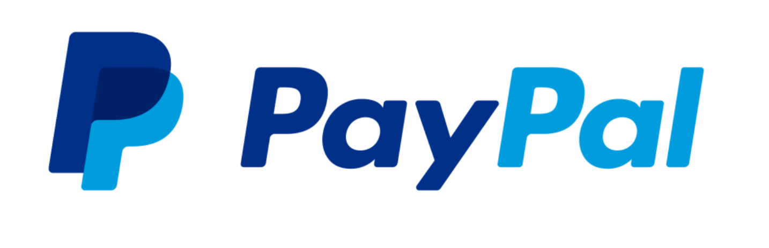
Disclaimer
The ideas, content, or opinions expressed in this presentation are solely those of the author and do not reflect any endorsement or support by our employer.

Slide 3

Whoami
Blake Hudson
Offensive Security Engineer at PayPal
Purple/Red Teamer
6+ years experience in cybersecurity
Specialize in infrastructure and cloud security
First time speaking at a conference!

Slide 4
What is a CI/CD Pipeline

Slide 5
What is CI/CD?
In simple terms, CI/CD pipelines help developers deliver code changes faster and with fewer errors by automating the testing and deployment processes.
CI (Continuous Integration): This involves automatically integrating code changes from multiple contributors into a shared repository several times a day. Automated tests run on the code to catch errors early.
CD (Continuous Deployment or Continuous Delivery): This involves automatically deploying the code to production or staging environments after it passes the tests, ensuring that new features and fixes can be released quickly and reliably.

Slide 6
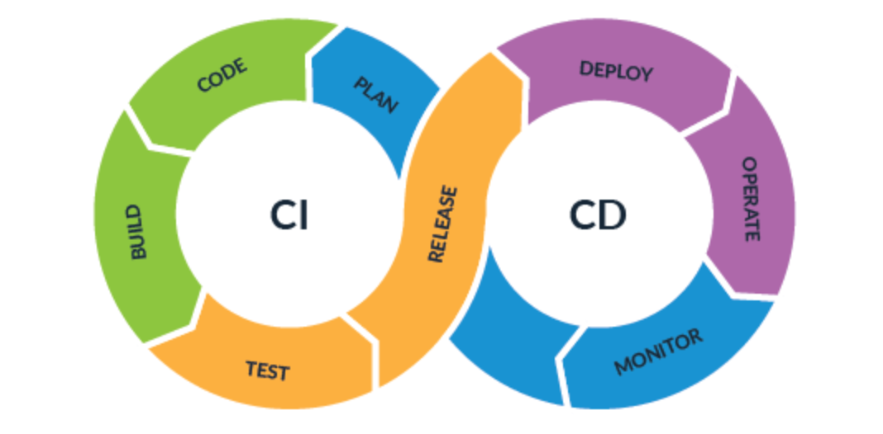
What is CI/CD?

Slide 7
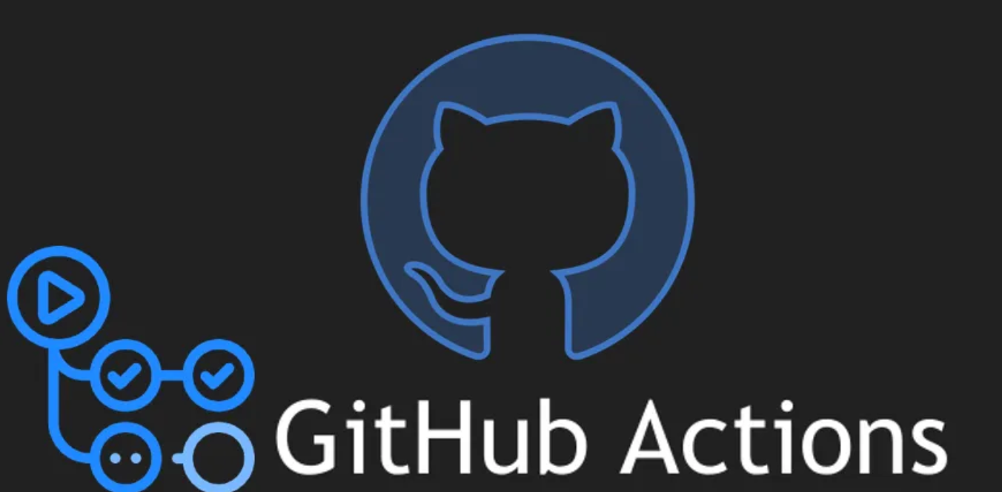




Who Are The Common Providers?

Slide 8
Some Common Uses in Todays Orgs:
Uses:
Code Quality Checks
IaC Deployment
Version Control Integration
Dependency/Artifact Management
Workflow Orchestration
Automated Testing

Slide 9
Why Do We Want To Test Them?

Slide 10
Why Test Them?
Identify potential vulnerabilities, misconfigurations, and weaknesses within the CI/CD pipeline's architecture, components, and processes.
Enhance an organizations CI/CD pipeline security posture and mitigate potential risks to their software development and deployment workflows.
Prevent threat actors from poisoning dependencies, software, and infrastructure deployed as code.

Slide 11
When Do We Test Them?
Cloud Penetration Tests
CI/CD Pipeline Specific Assessment
Red Team Engagement
Internal Network Assessments

Slide 12

What Permissions Are Needed?
Standard developer user within their repositories
Standard developer user within their pipeline software

Slide 13

Commonalities?
Most of these CI/CD pipeline providers operate the same way.
If you know how to exploit/manipulate one of them, you can exploit many of them.

Slide 14
Pwn To Own?
Exploiting CI/CD Pipelines to Hack The Cloud

Slide 15
The Basics and The Obvious
Common Attack Paths

Slide 16
Looking At Repositories
Searches:
AWS Access Keys
GitHub personal access tokens (PAT)
Jenkins credentials
CircleCI credentials
Azure ClientID and Secrets
GCP Service Account Keys
[runs-on]
Terraform Cloud API Key

Slide 17
What Are They Using?
Look for specific folders:
Jenkinsfile
.circleci
.github
.harness
.teamcity

Slide 18
More Interesting
Attack Paths

Slide 19

Everything You Need Is Right In Front Of You
Reviewing existing pipeline yaml files within a repo can tell you everything that you need to know of how they are using the pipeline to interact with their infrastructure.

Slide 20
Where Are The Secrets?

Slide 21
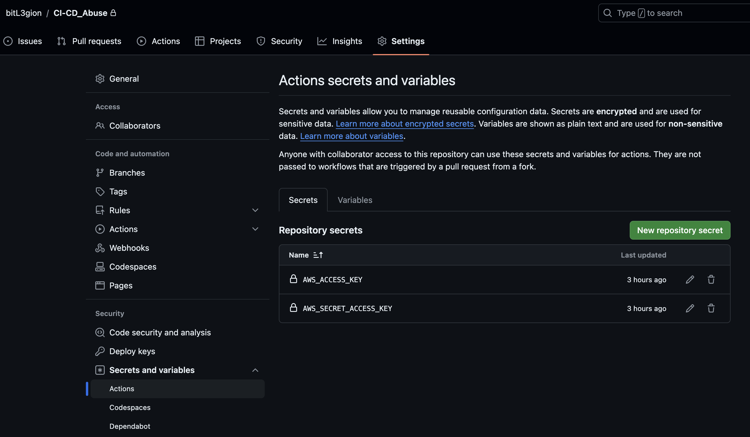
Where Are The Secrets - GitHub
Blake Hudson

Slide 22
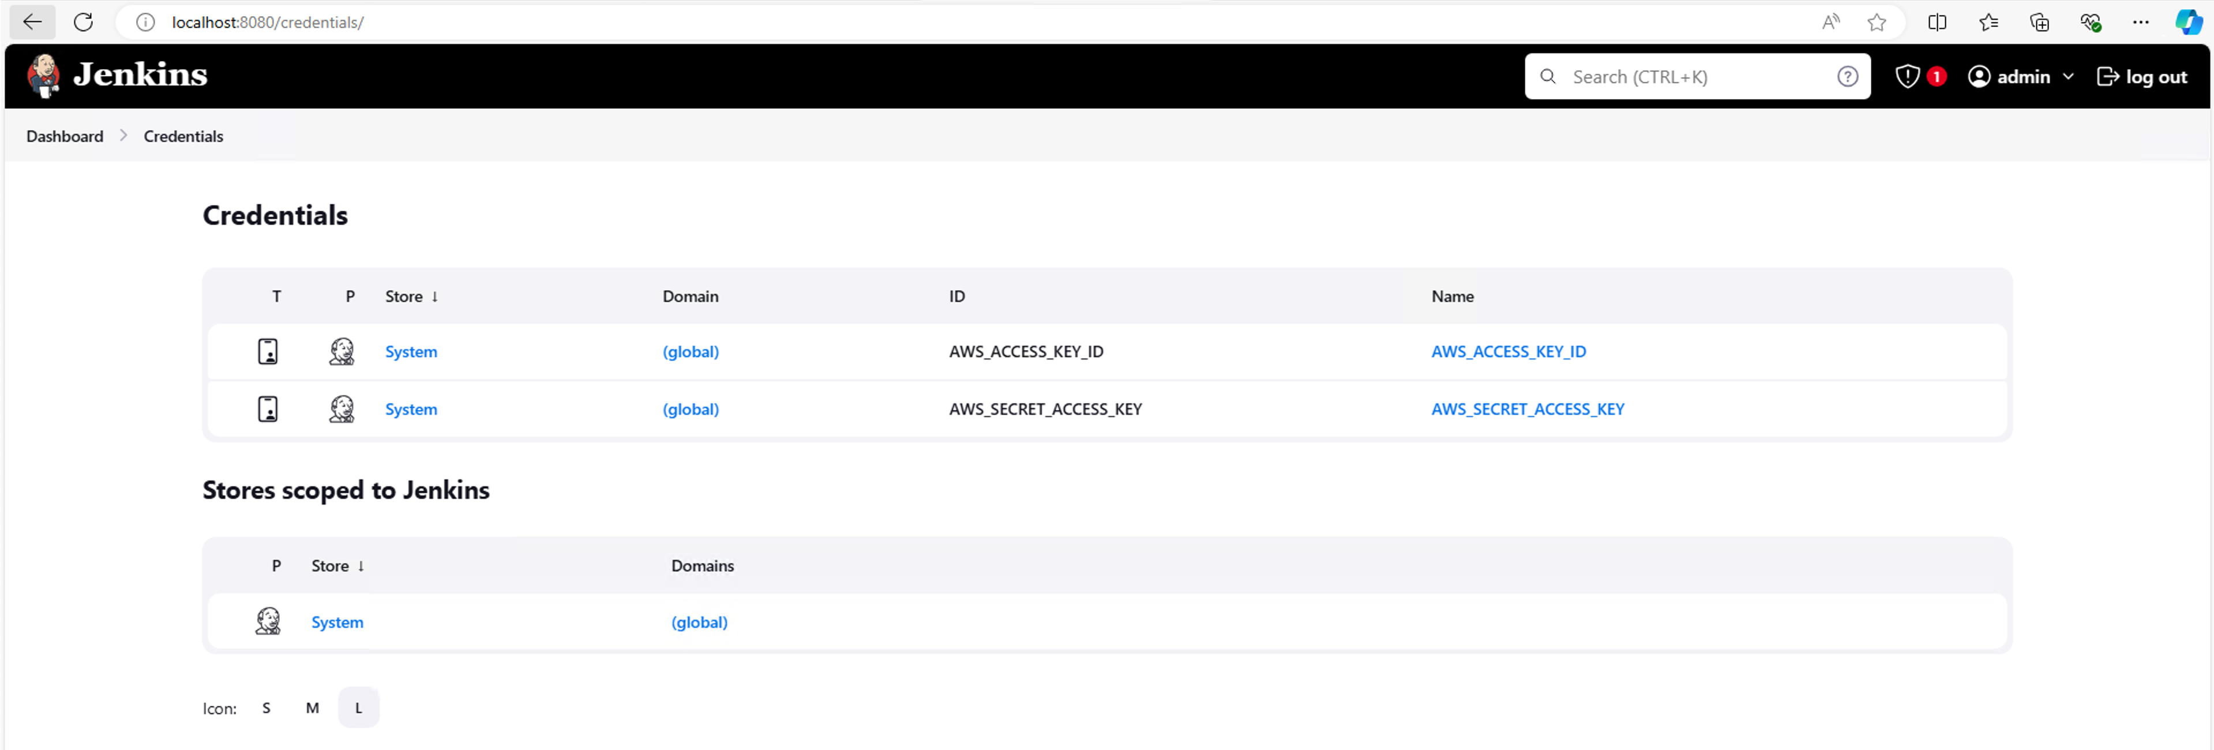
Where Are The Secrets - Jenkins
Blake Hudson

Slide 23
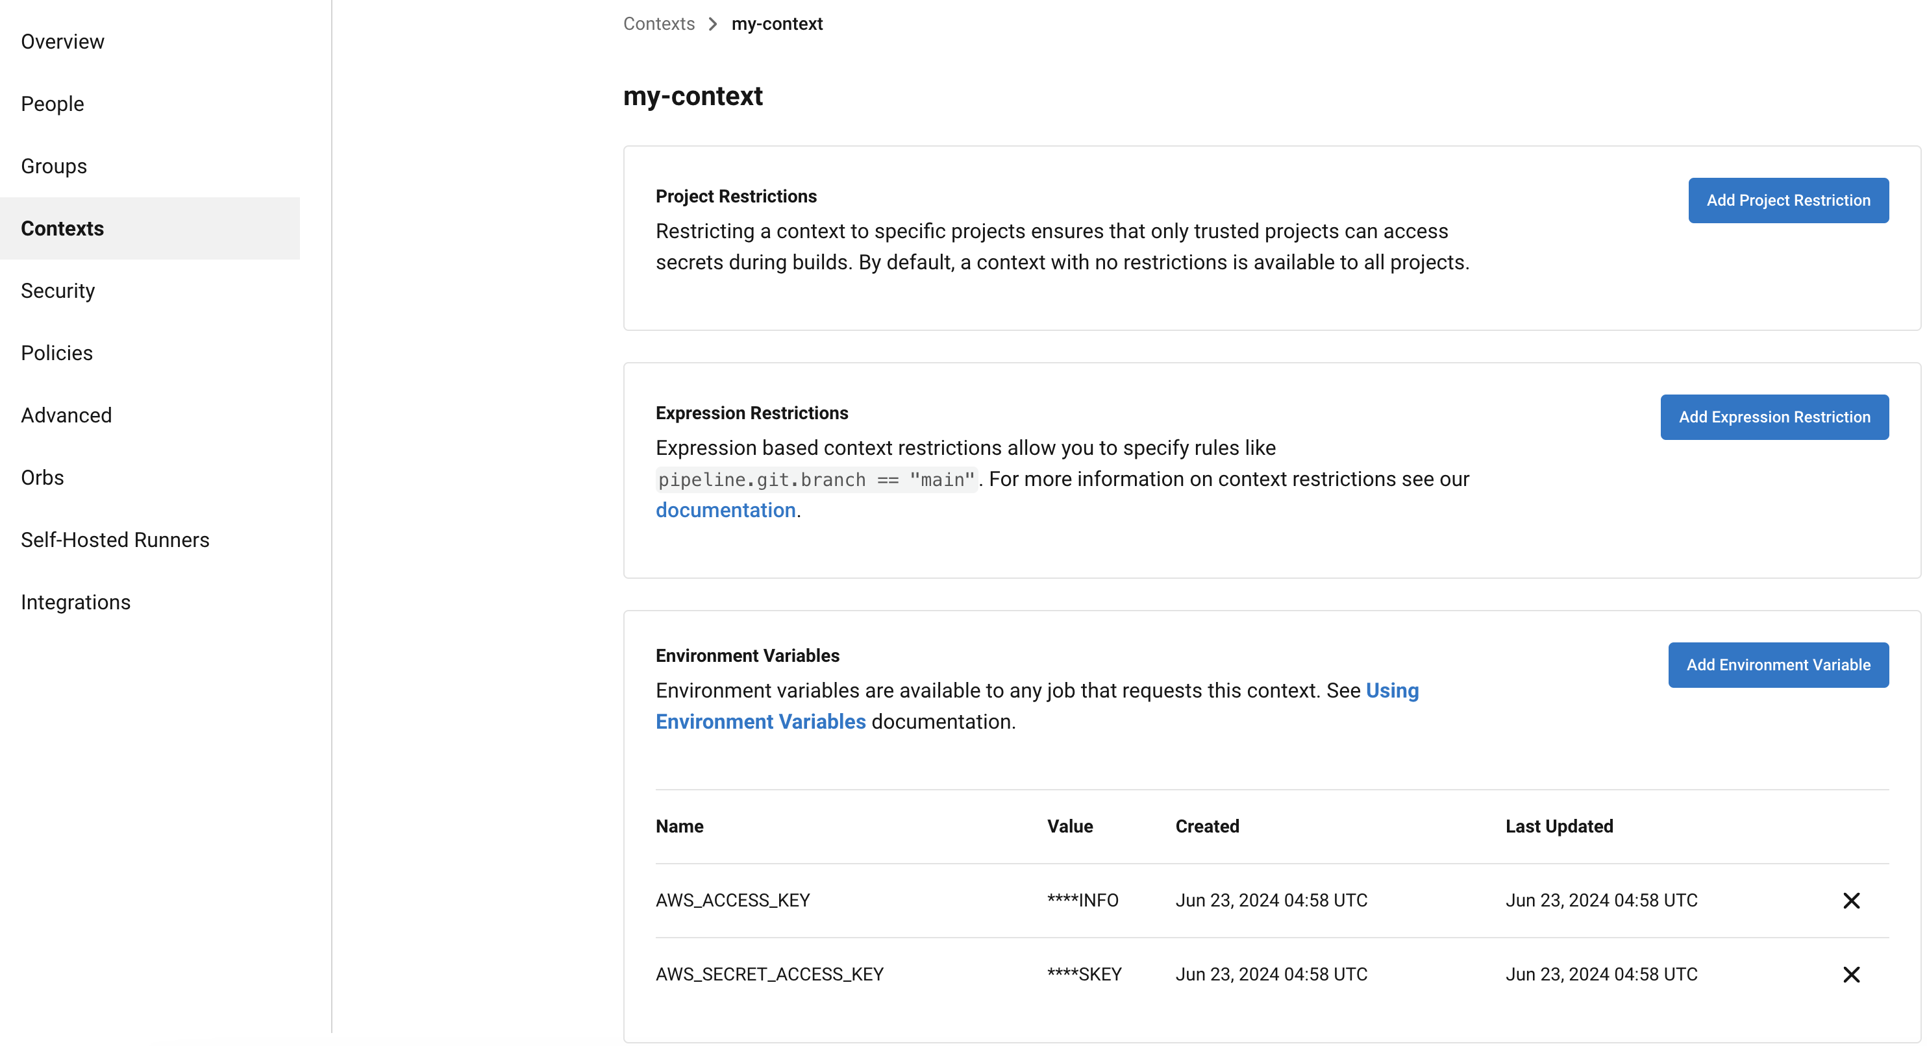
Where Are The Secrets - CircleCI
Blake Hudson

Slide 24
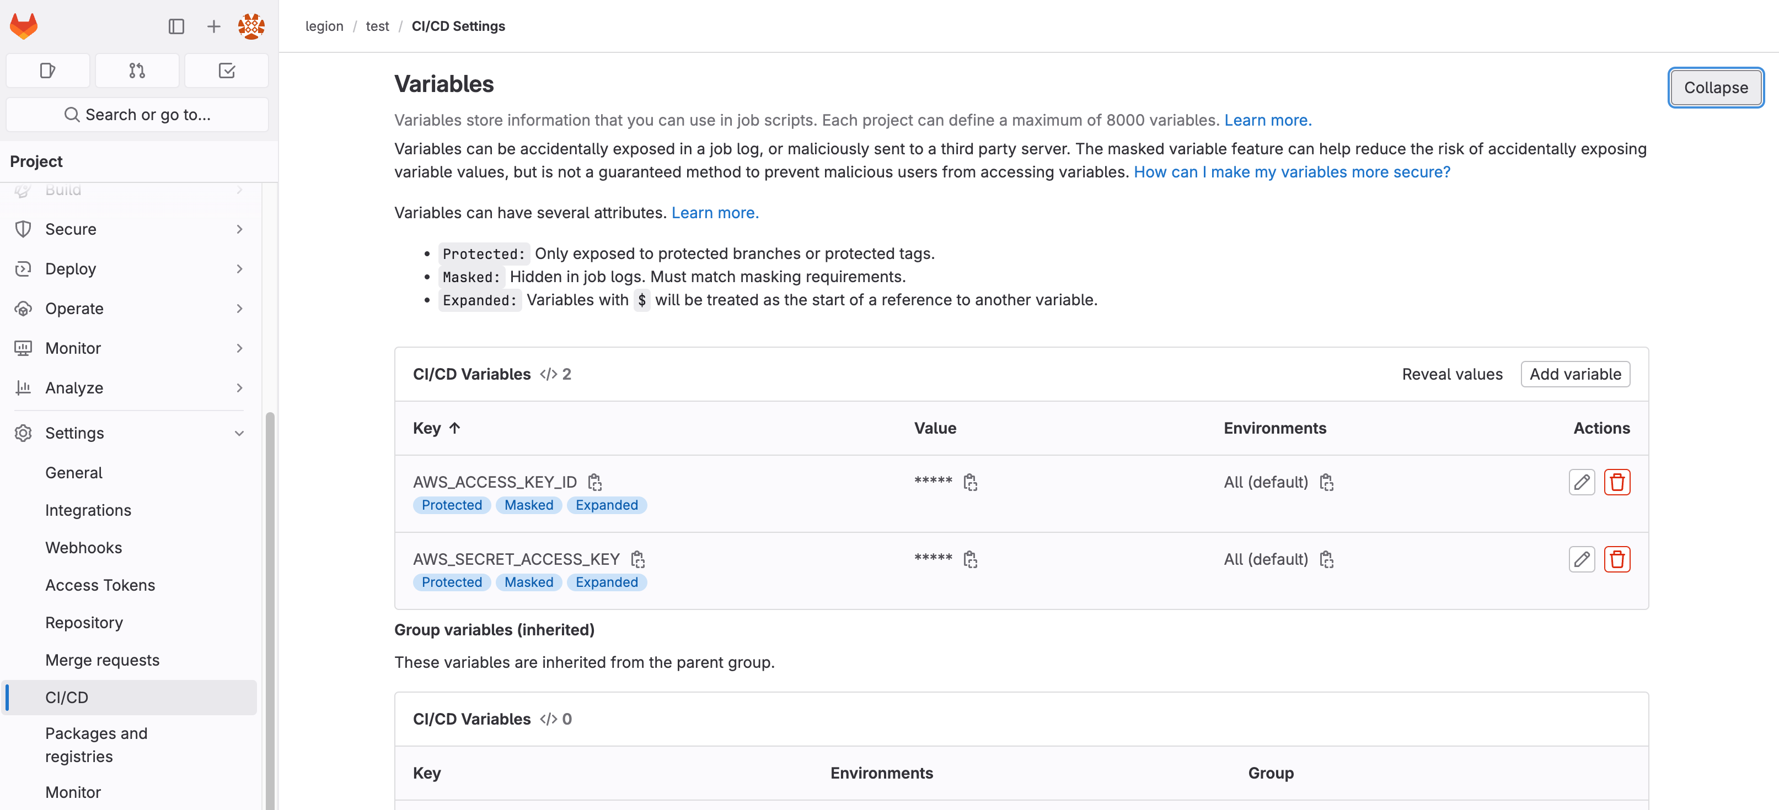
Where Are The Secrets - GitLab
Blake Hudson

Slide 25
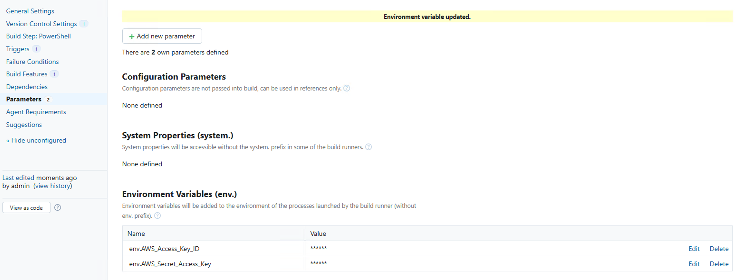
Where Are The Secrets - Teamcity
Blake Hudson

Slide 26
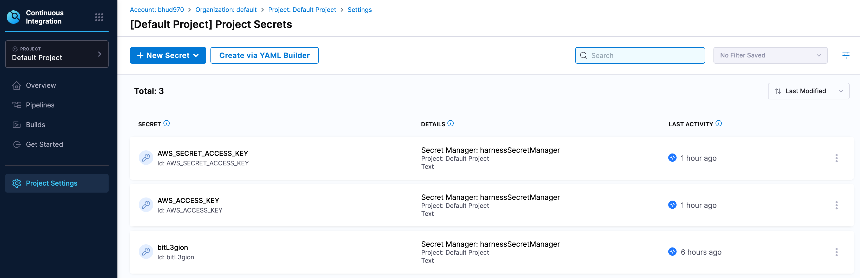
Where Are The Secrets – Harness
Blake Hudson

Slide 27
How Do We Access Them?
Typically, you cannot access the secrets once they are set.
Only the pipelines configured to use them can access the secrets.
However, you can review the existing yaml files for which actions are calling specific secrets by name and importing them.
Some secrets may be forgotten in the variables and no longer called.
Very slow to do manually…

Slide 28
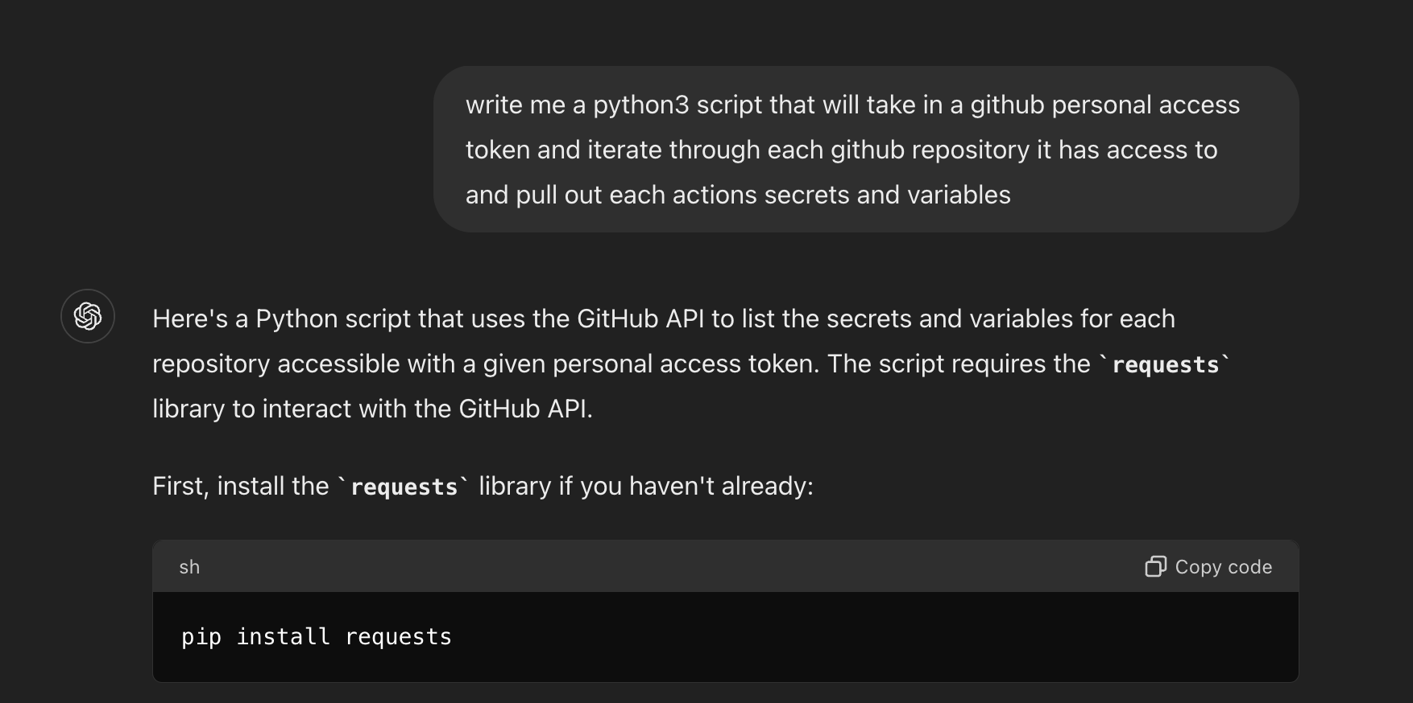
ChatGPT For The Assist

Slide 29
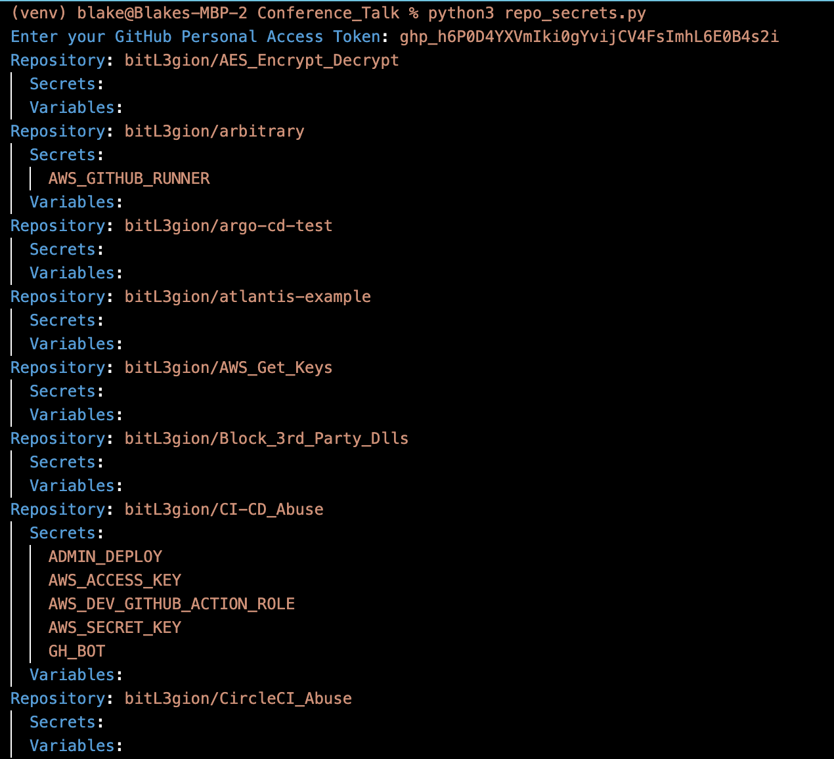
ChatGPT For The Assist
Blake Hudson

Slide 30
Stealing Credentials – GitHub Actions
Now that we have identified which repositories are storing credentials we can begin trying to steal them:
Create a new branch for the repository
Add new yaml file in the workflows to extract the secrets
Commit the file to your new branch
Profit!

Slide 31
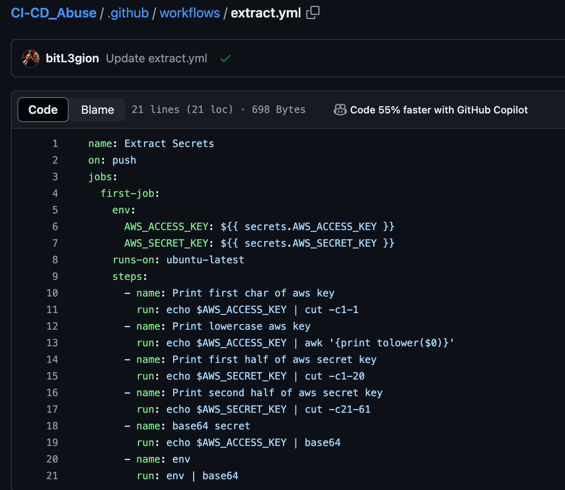
Stealing Credentials – GitHub Actions
Now that we identified what repositories are storing secrets, we can create a new workflow and commit it to a new branch of the specific repo

Slide 32
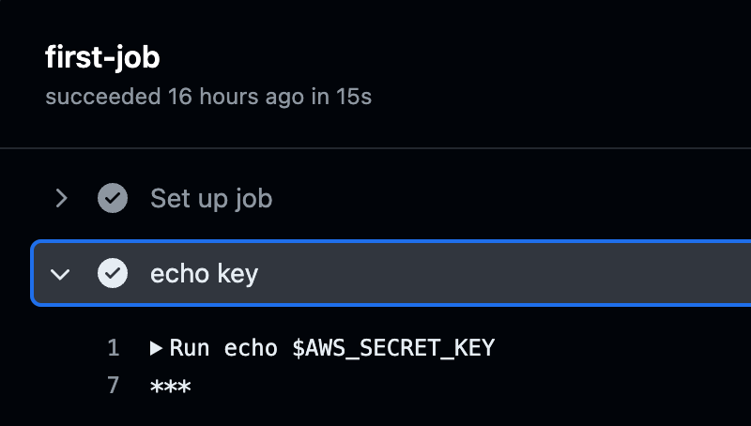
Stealing Credentials – GitHub Actions
CI/CD providers due their best to mask potential secrets.
This is easily worked around to access them in cleartext

Slide 33
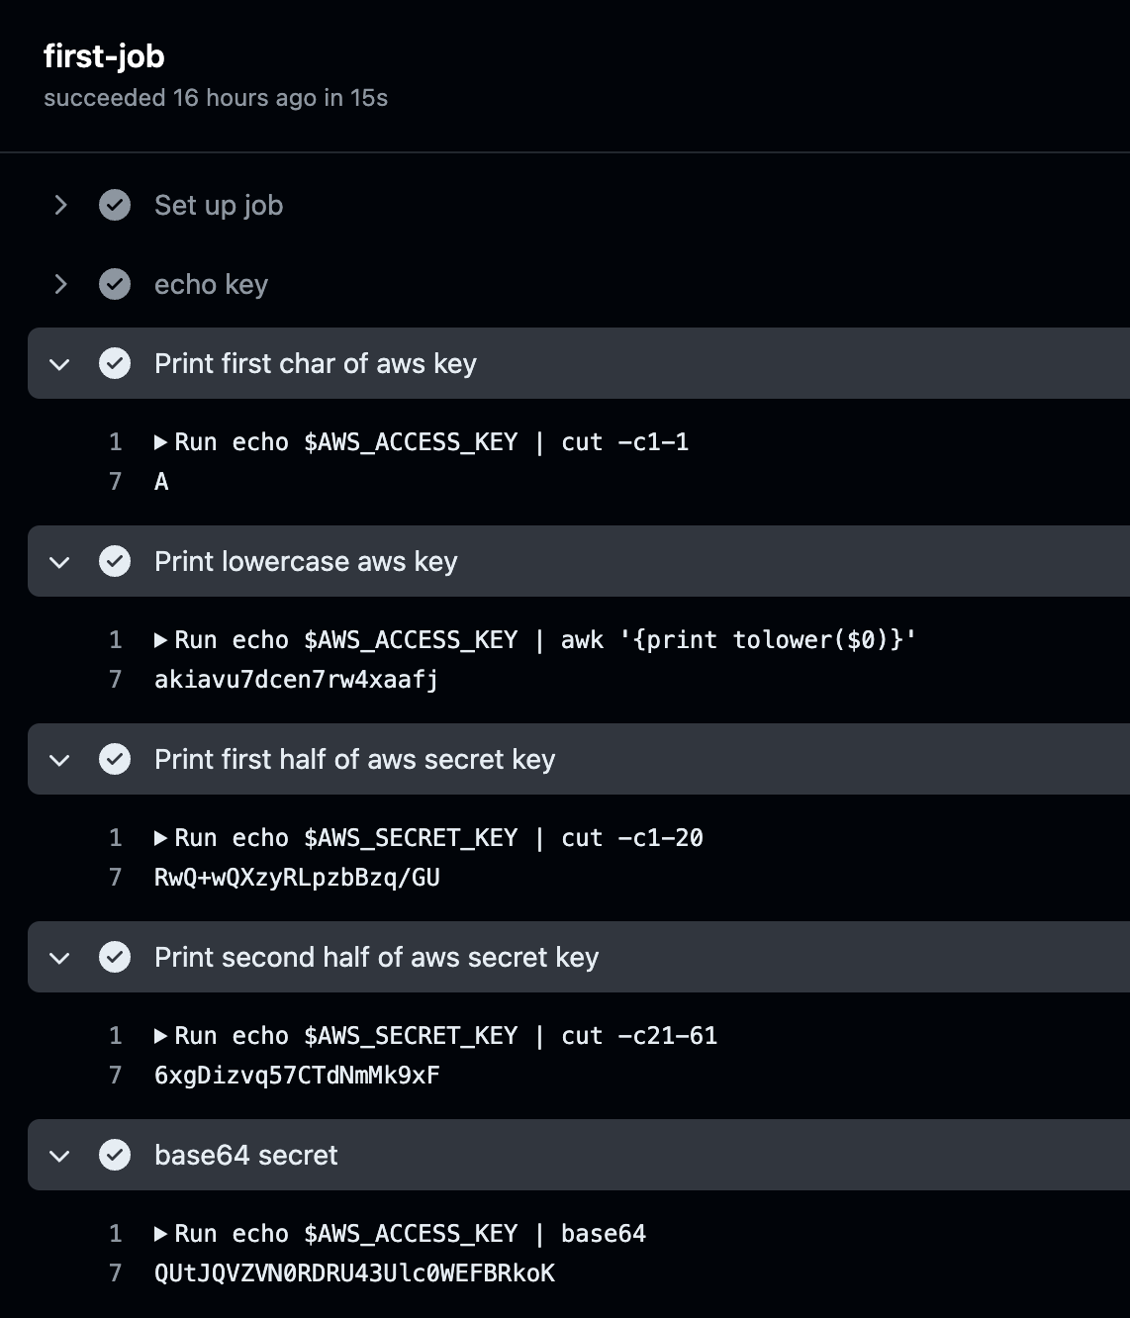
Stealing Credentials – GitHub Actions
Several path to access the cleartext secrets.
Manipulate the variables in a way that its no longer identified as a secret.

Slide 34
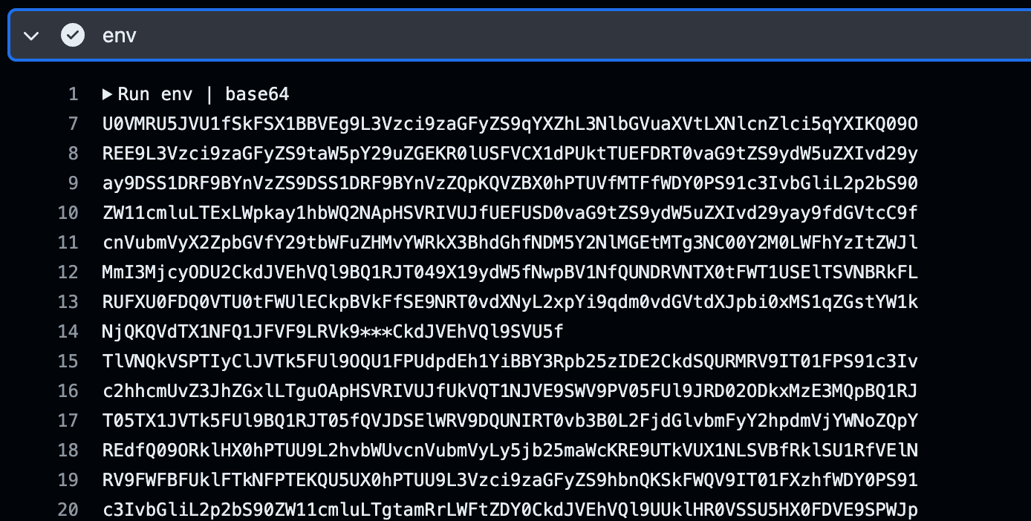
Stealing Credentials – GitHub Actions
Base64 encode the runner's environment variables.
Depending on the runner being used there might be a lot more useful information or credentials within the env.

Slide 35
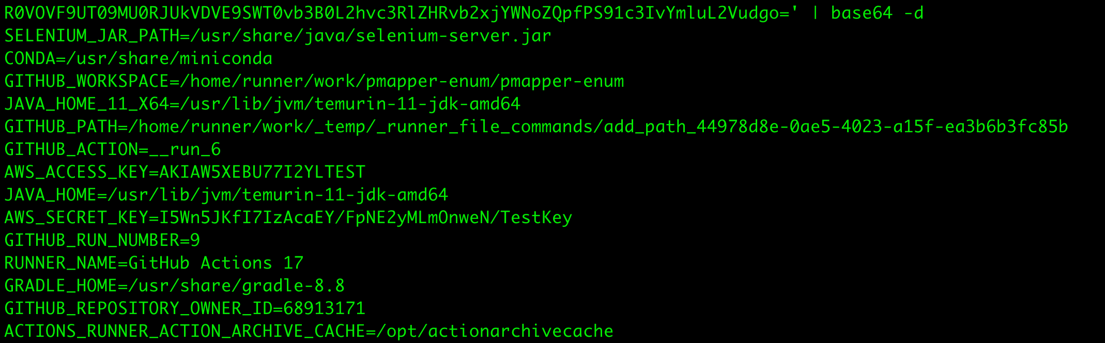
Stealing Credentials – GitHub Actions
Copy the base64 encoded blob out of the console output and decode.
echo ‘<Base64_encoded_env>’ | base64 –d
You can use these keys externally now, or continue to create workflows to interact with AWS
Blake Hudson

Slide 36
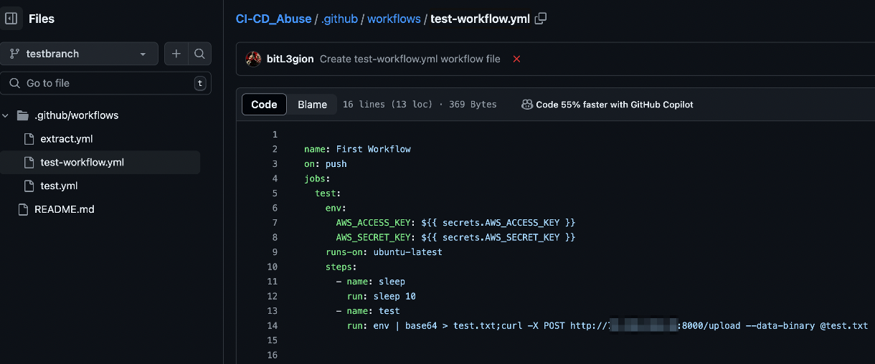
Stealing Credentials – GitHub Actions
If we have a GitHub personal access token, we can automate this and send the ENV variables to a system we control!

Slide 37
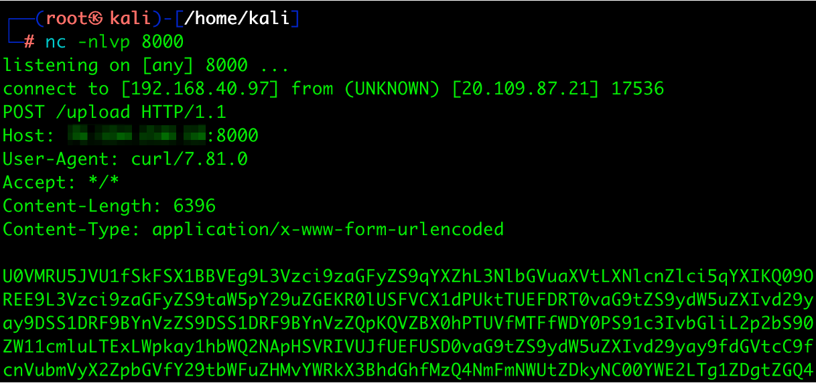
Stealing Credentials – GitHub Actions
Successful workflow execution and collection of the ENV variables.

Slide 38
What About Other Secrets?

Slide 39
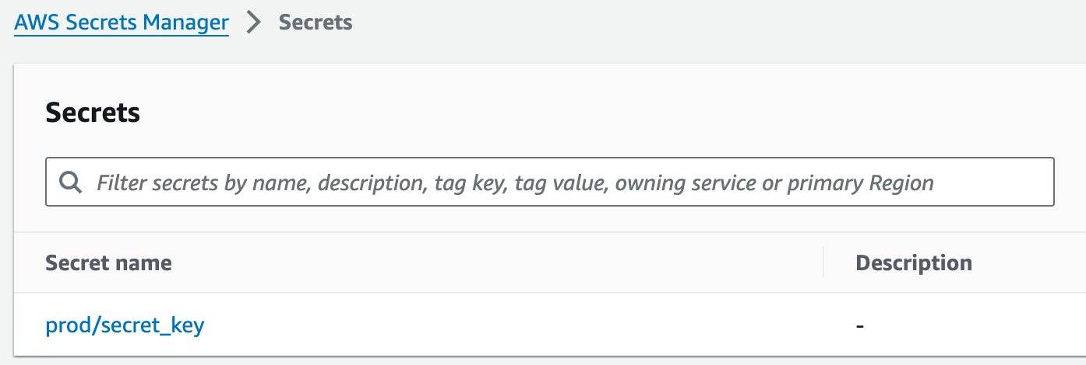
Stealing Credentials – Secrets Manager
There could be a lot of secrets stored in AWS Secrets Manager.
AWS roles used in the CI/CD pipeline may need to access these secrets for a lot of different reasons.

Slide 40
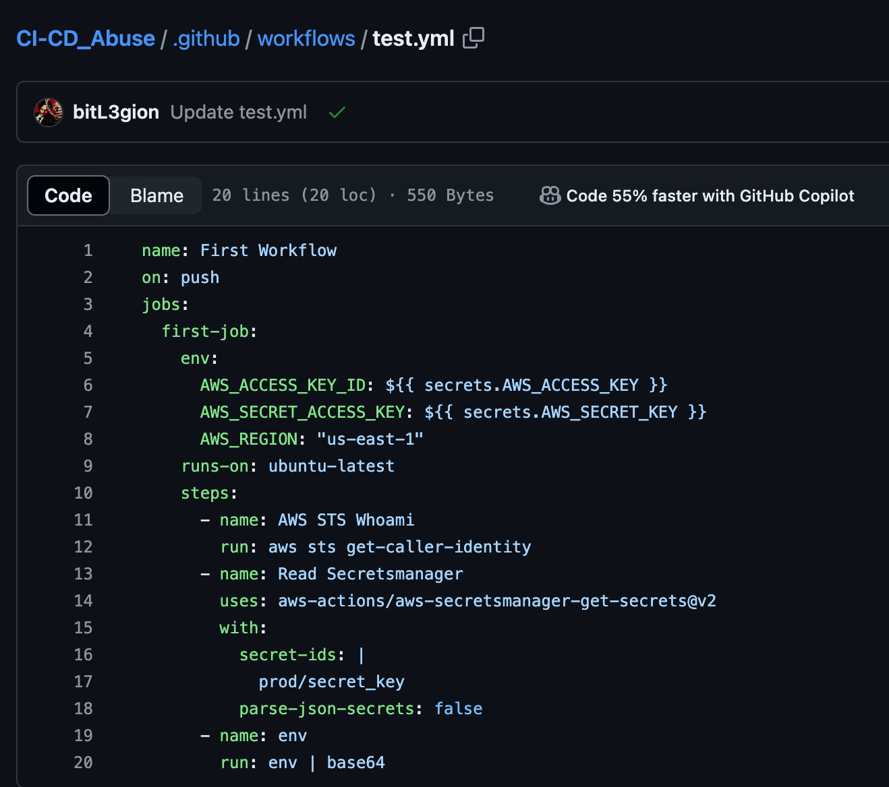
Stealing Credentials – Secrets Manager
If the role has ability to read secrets from Secrets Manger, editing your initial workflow can allow you to import them into the runner's environment variables.

Slide 41
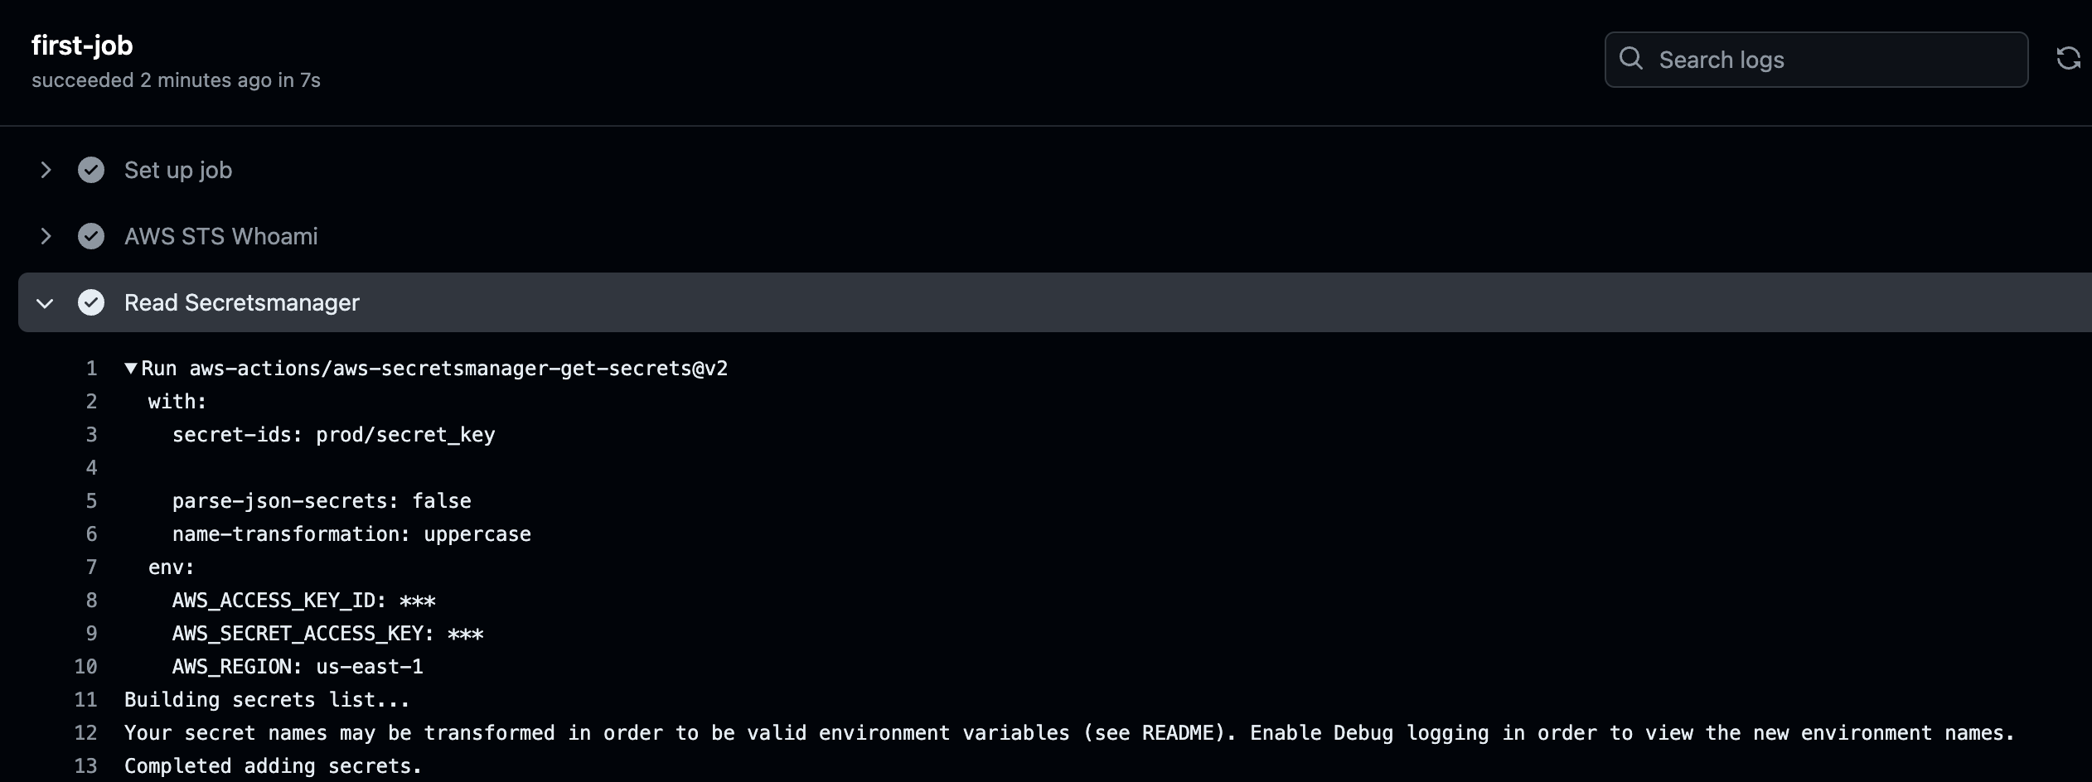
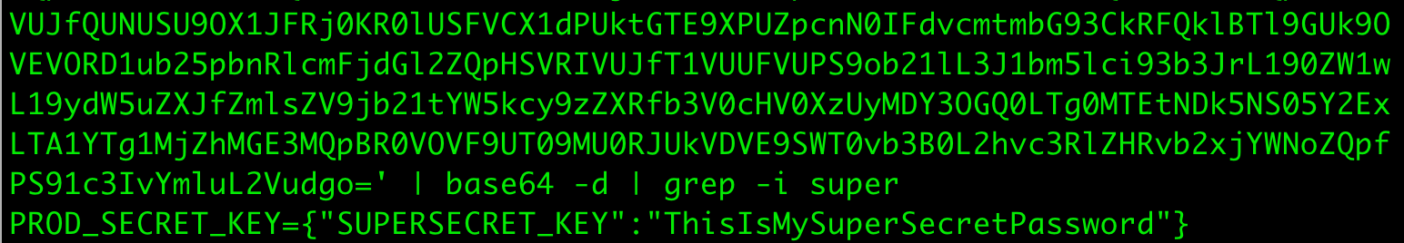
Stealing Credentials – Secrets Manager

Slide 42
What Next?

Slide 43
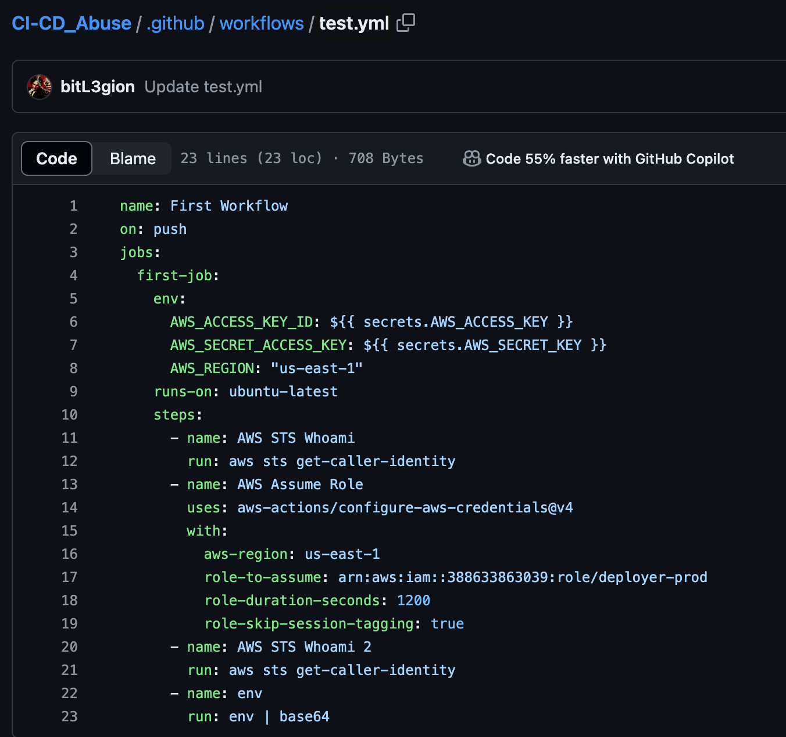
How About Assuming Roles?
Reading other workflow yaml files can tell you exactly what roles can be assumed and how its done.
This runner will import AWS access keys from the repo secrets and assume the role into the deployer-prod role.

Slide 44
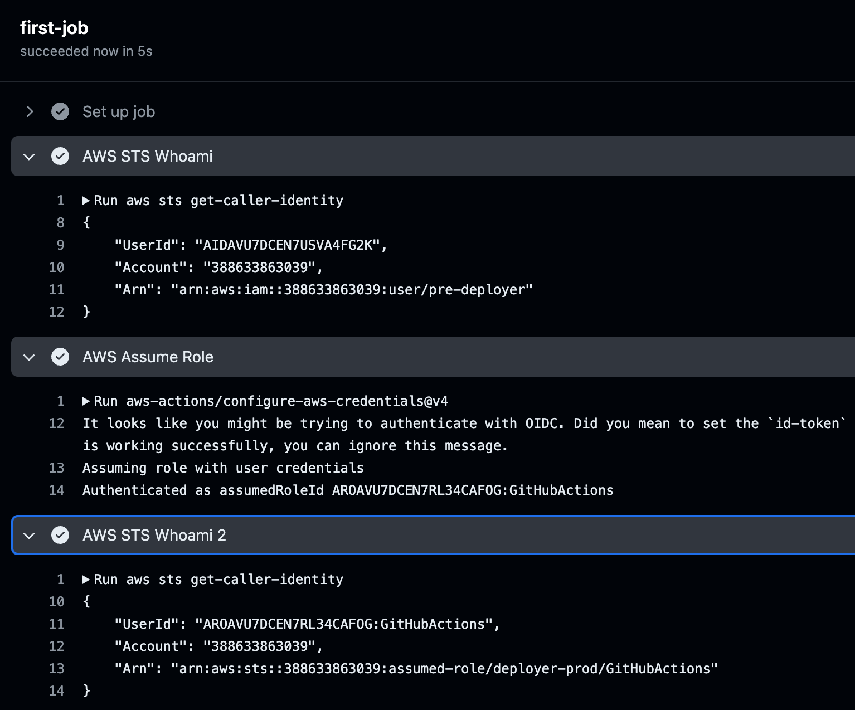
How About Assuming Roles?
Action successfully assumed the role, which happens to be an administrator in the AWS Account.
You can continue to use your access from here and issue AWS commands, or exfil the assumed roles AWS access keys to use offline.

Slide 45
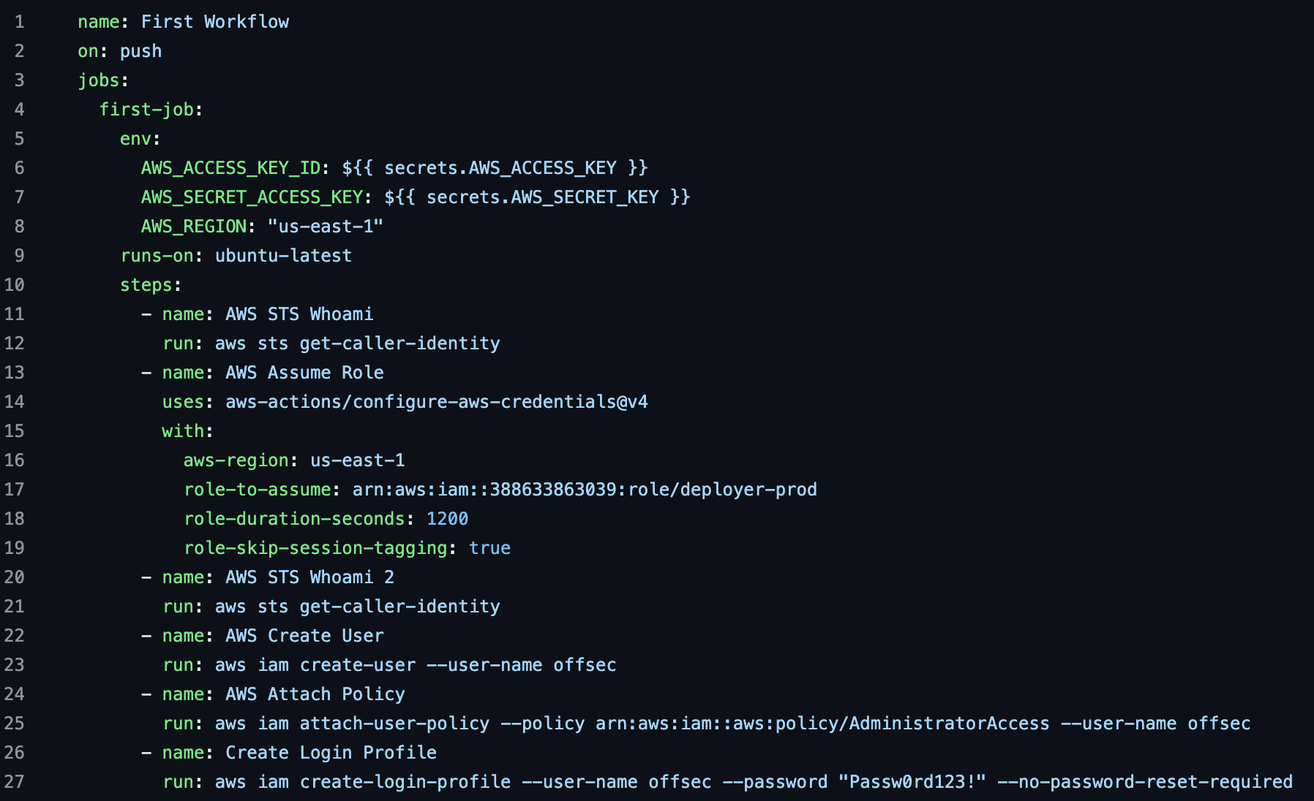
How About Assuming Roles?
Since the deployer-prod assumed role is an administrator, why not create a new user to log into the AWS management console?

Slide 46
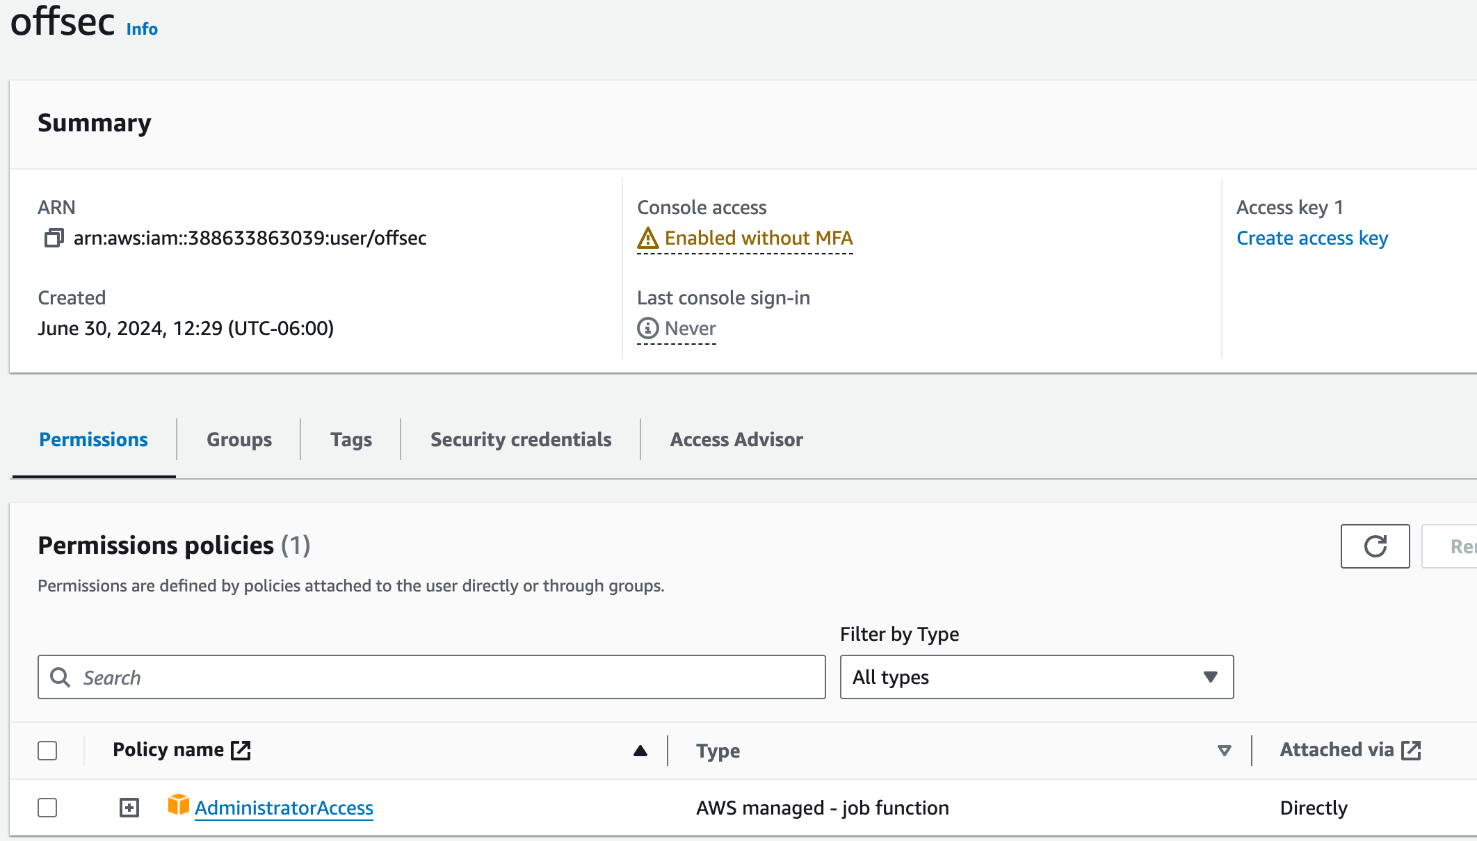
How About Assuming Roles?
The offsec user successfully created, and the administrator policy attached.

Slide 47
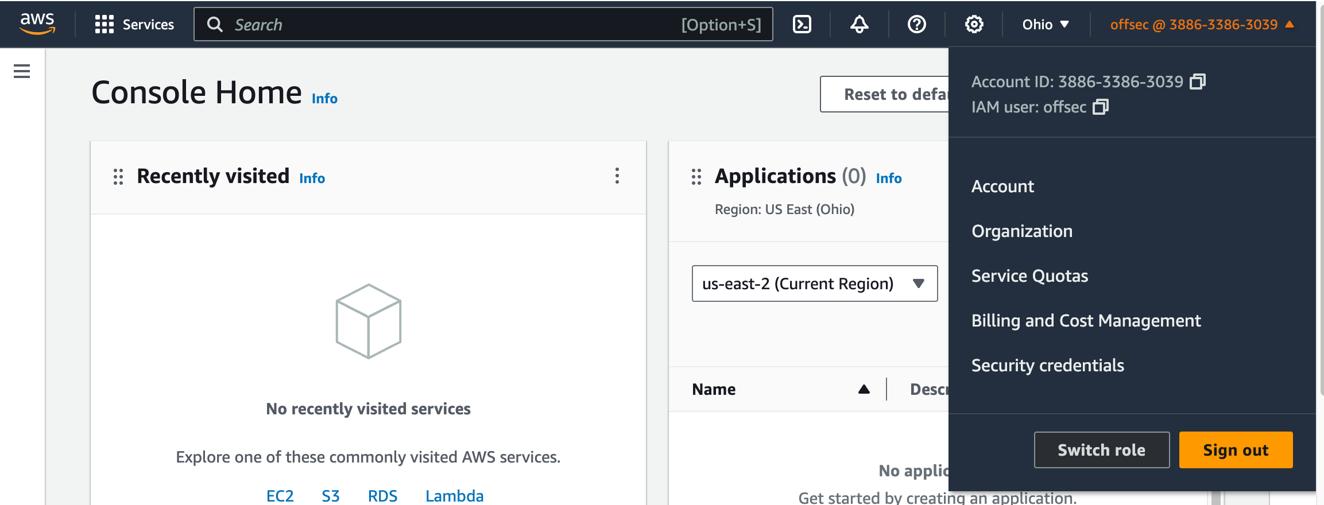
How About Assuming Roles?
You can now access the AWS management console as a full administrator user.

Slide 48
What About Trust Relationships?

Slide 49
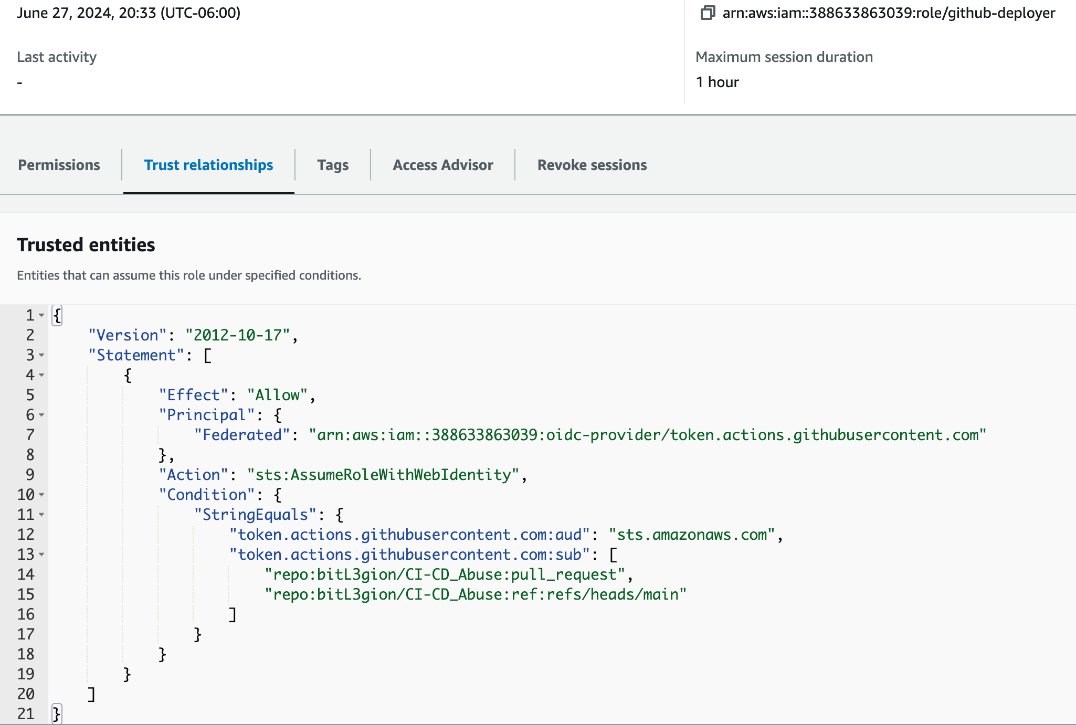
Trust Relationships
This Trust relationship for the github-deployer role is restricted.
A GitHub Action can only interact with this role if it’s coming from the CI-CD_Abuse repository and with a Pull Request.

Slide 50
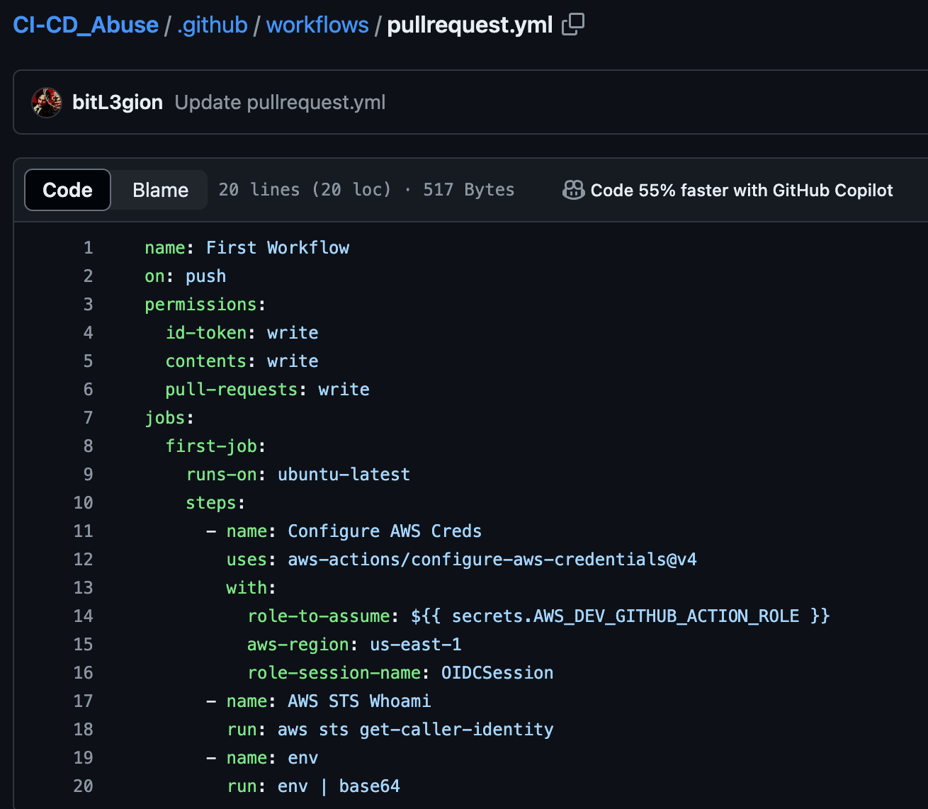
Trust Relationships
If we create a workflow in that repository to interact with the AWS role, it will fail because this will execute on ‘push’ and not a pull request.

Slide 51
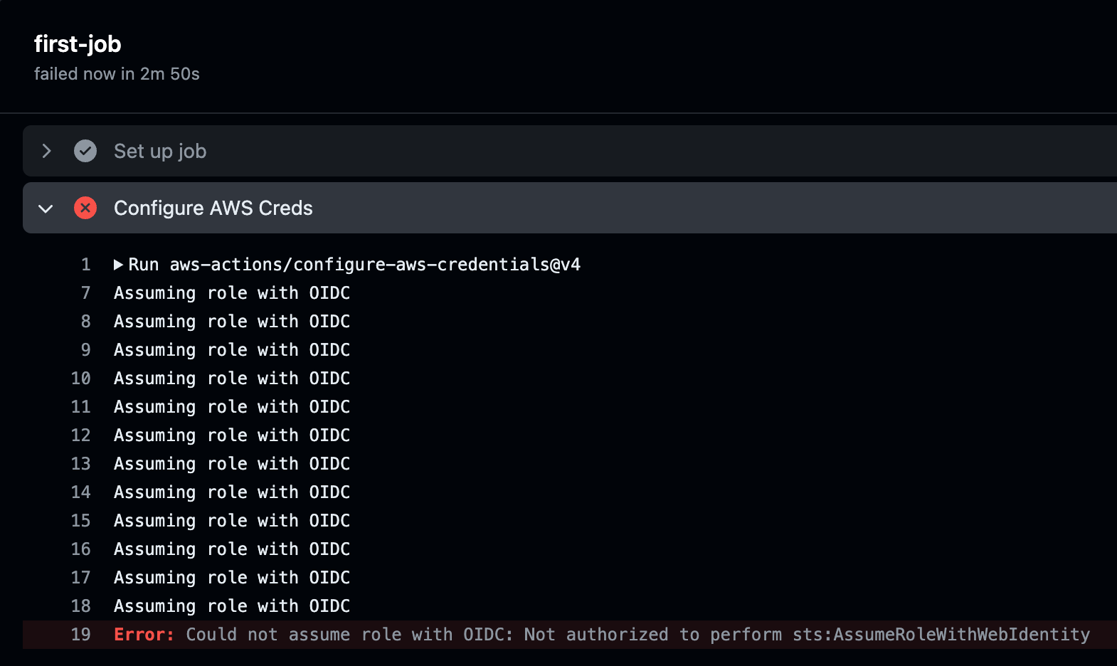
Trust Relationships – Blocked!
This workflow failed as it was not executing from a pull request like the trust relationship described.

Slide 52
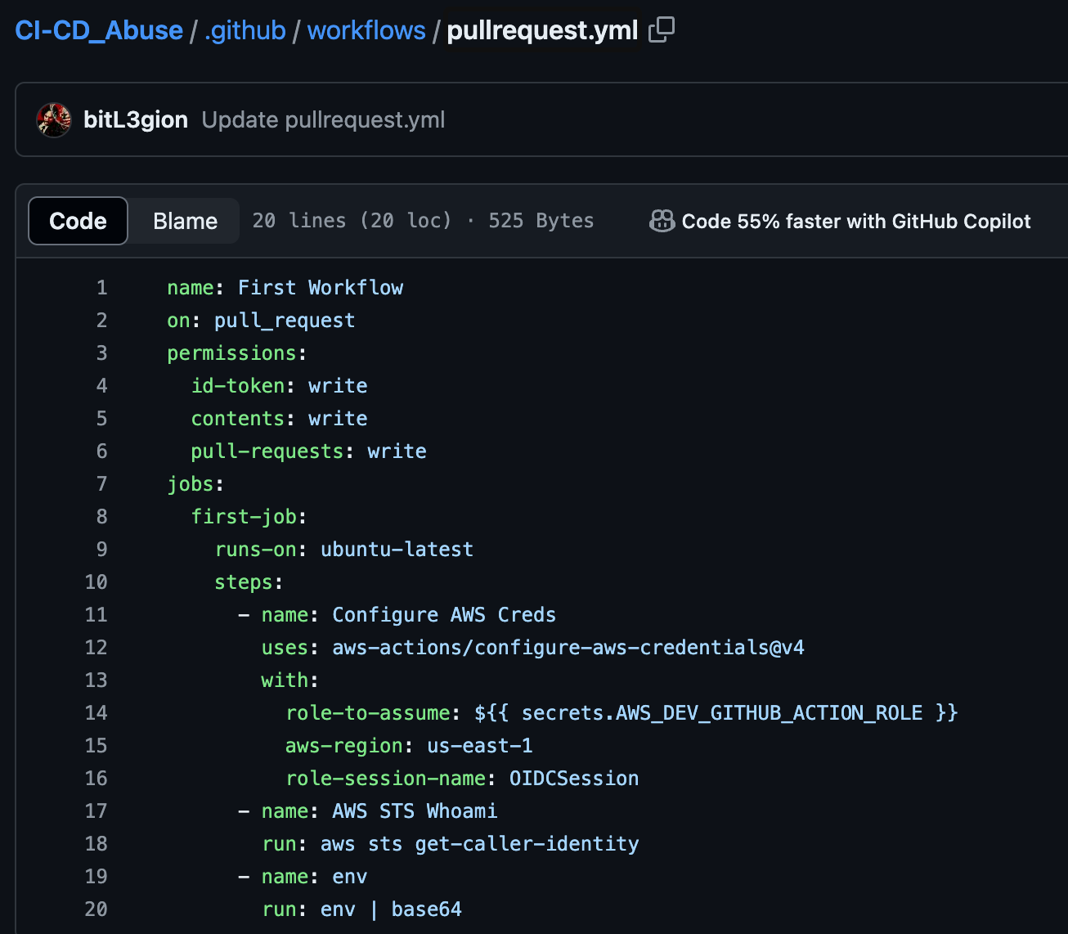
Trust Relationships
To bypass this restriction, we change the yaml to execute on ‘pull_request’ instead of ’push’.

Slide 53
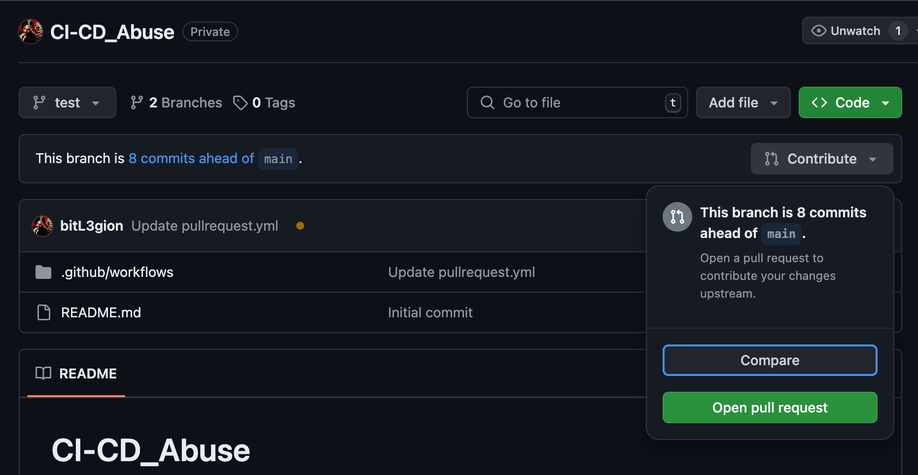
Trust Relationships
The workflow won’t execute until you submit a pull request.

Slide 54
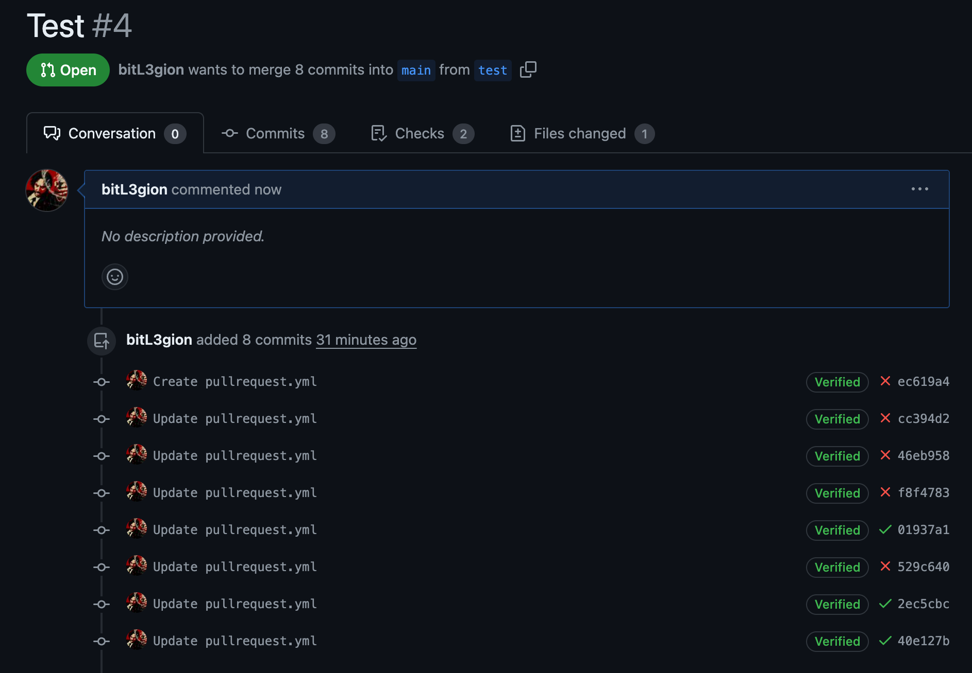
Trust Relationships
The pull request does NOT need to be accepted or denied. As soon as you submit the PR the workflow will execute.

Slide 55
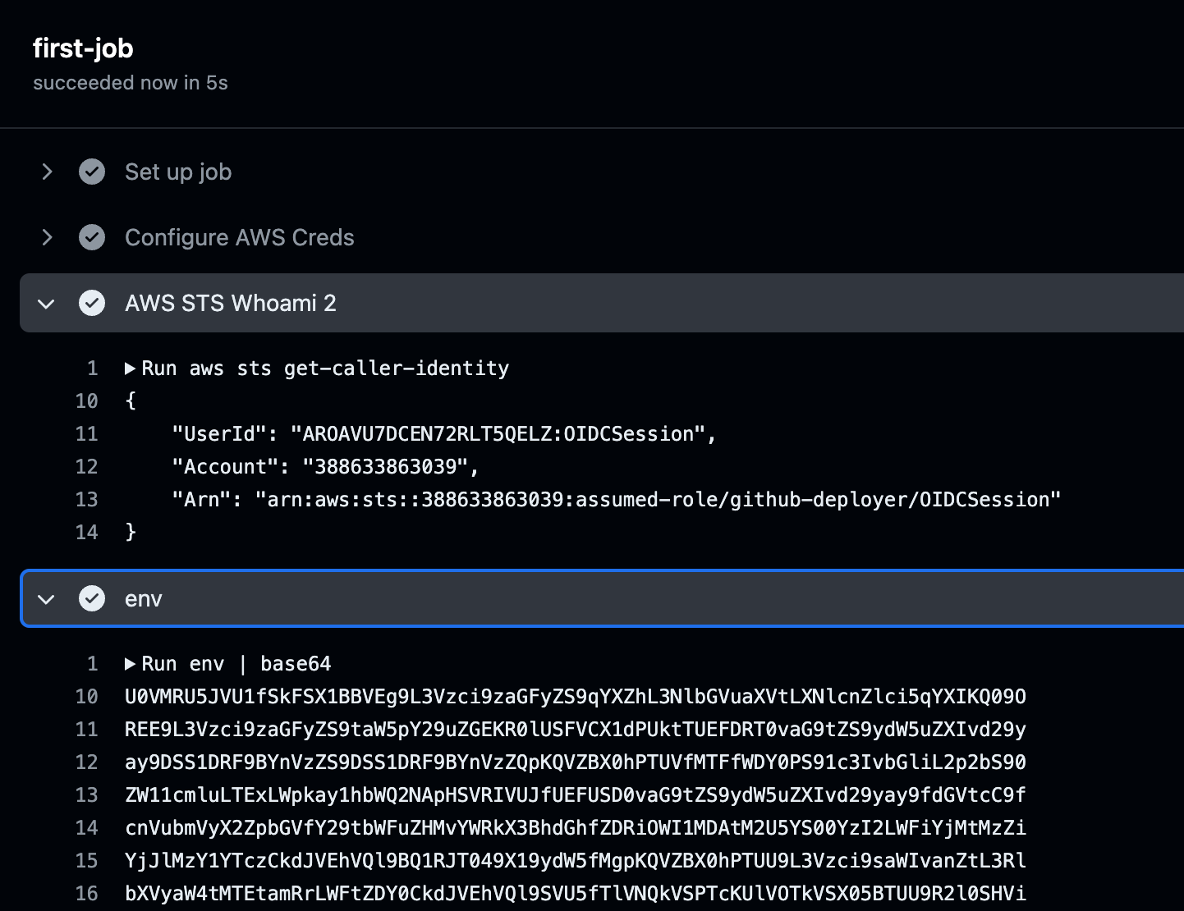
Trust Relationships
The workflow executed successfully, granting us access to the restricted role and its AWS access keys.
You can then go in and close the pull request and delete your branch to clean up.

Slide 56
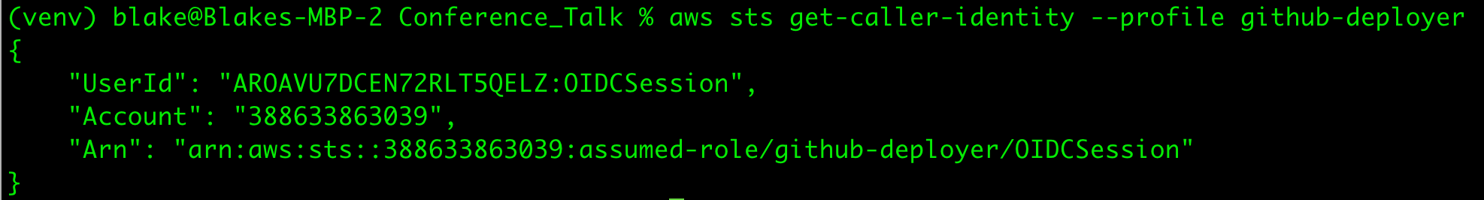
Trust Relationships
Although there is a trust restriction to assume this OIDC role, you become authenticated once the workflow runs successfully.
Base64 encode these secrets, exfil them and import into your AWS credentials file to use externally.

Slide 57
Other Trust Relationships

Slide 58
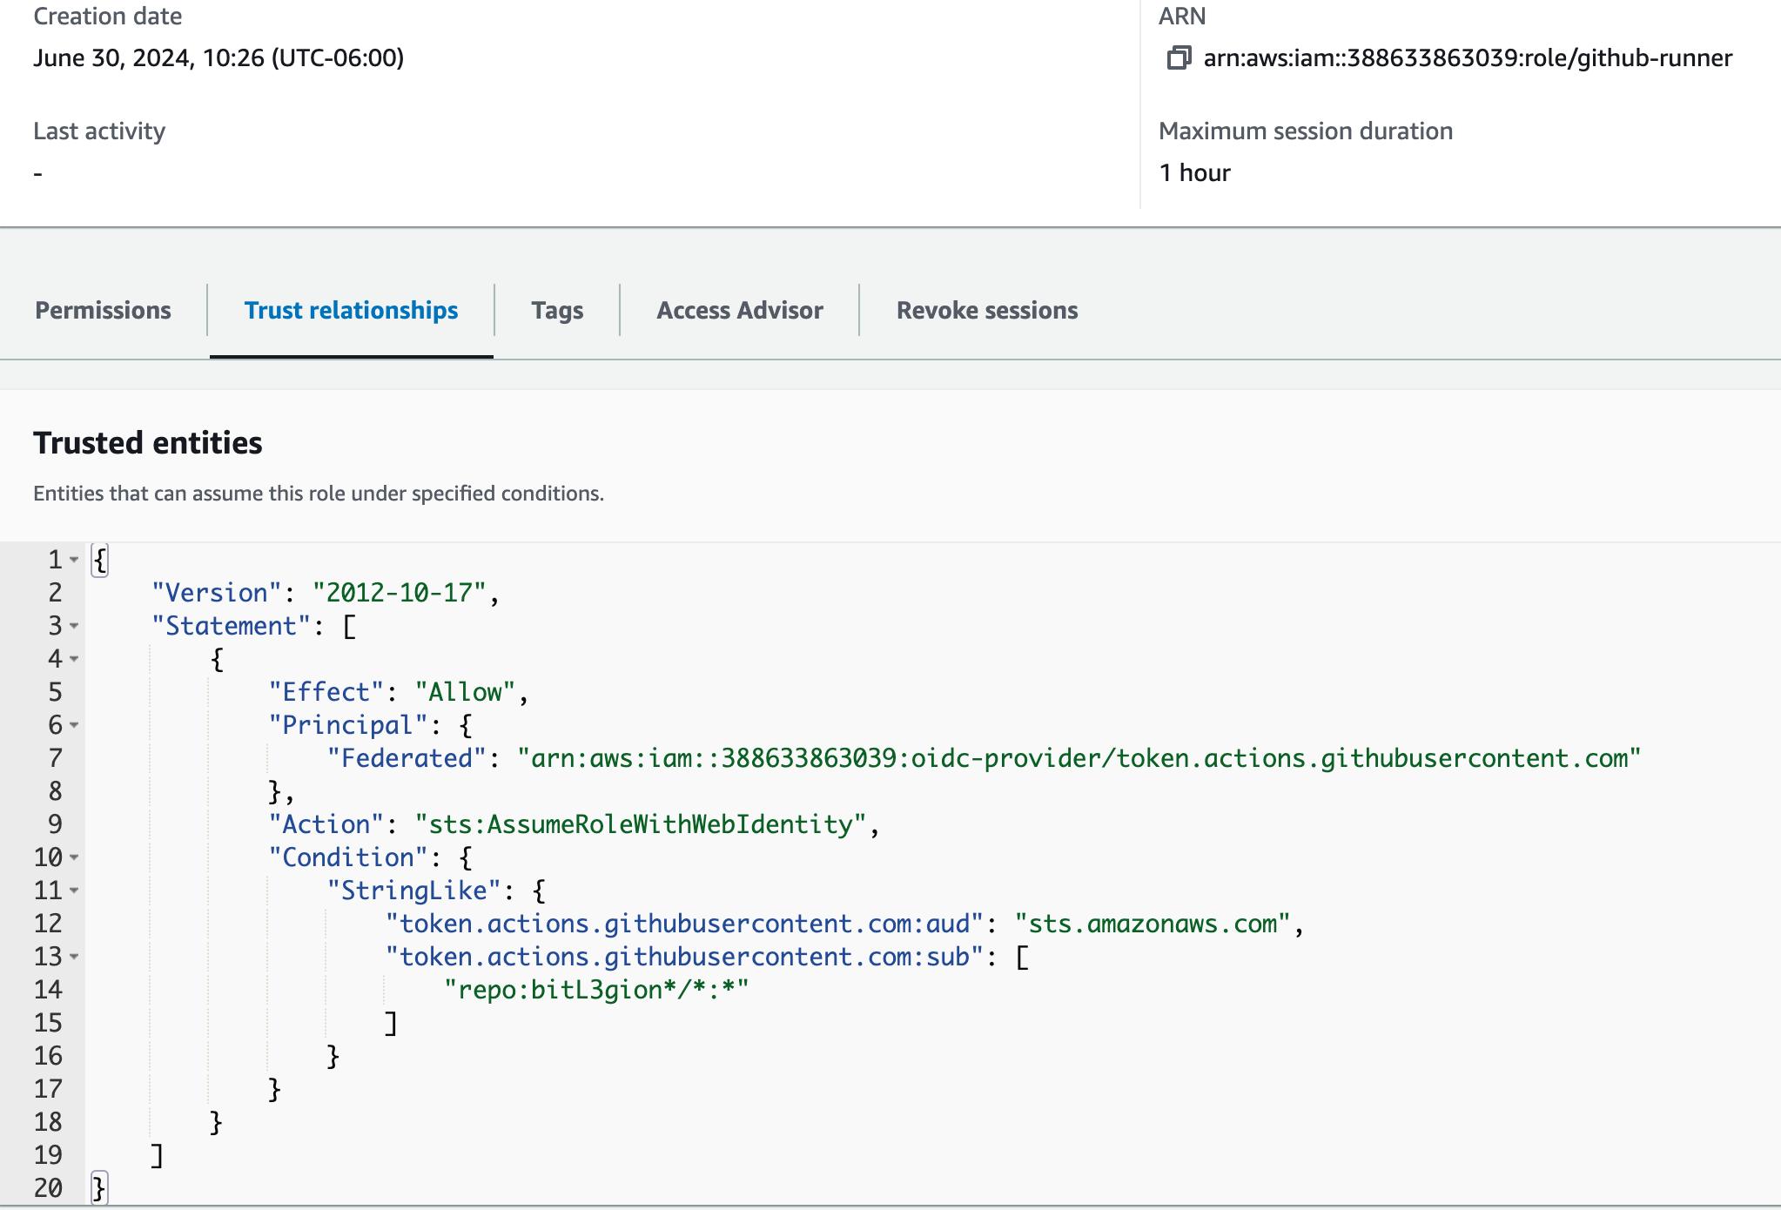
Other Trust Relationships
This trust relationship allows for any repository and any branch under bitLegion* to interact and assume the OIDC github-runner role

Slide 59
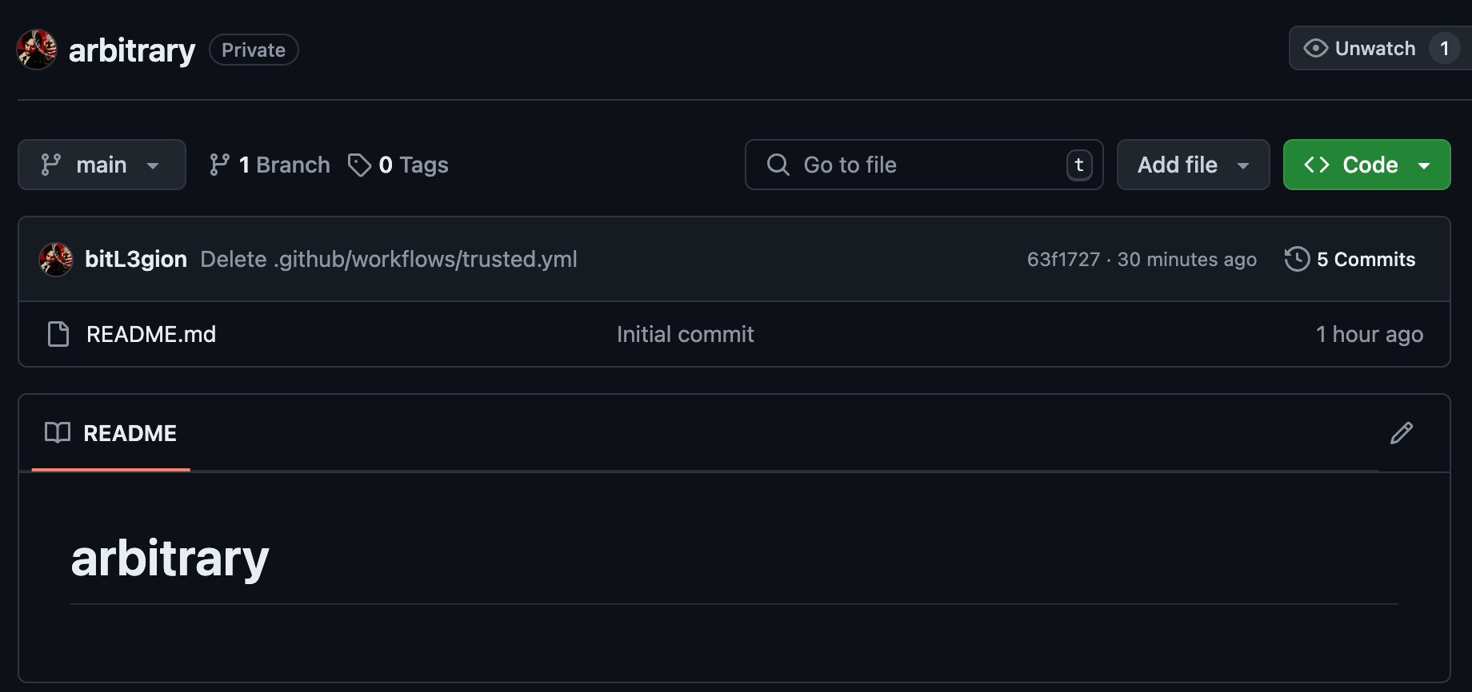
Other Trust Relationships
We can create a new repo or use an existing repo within the organization

Slide 60
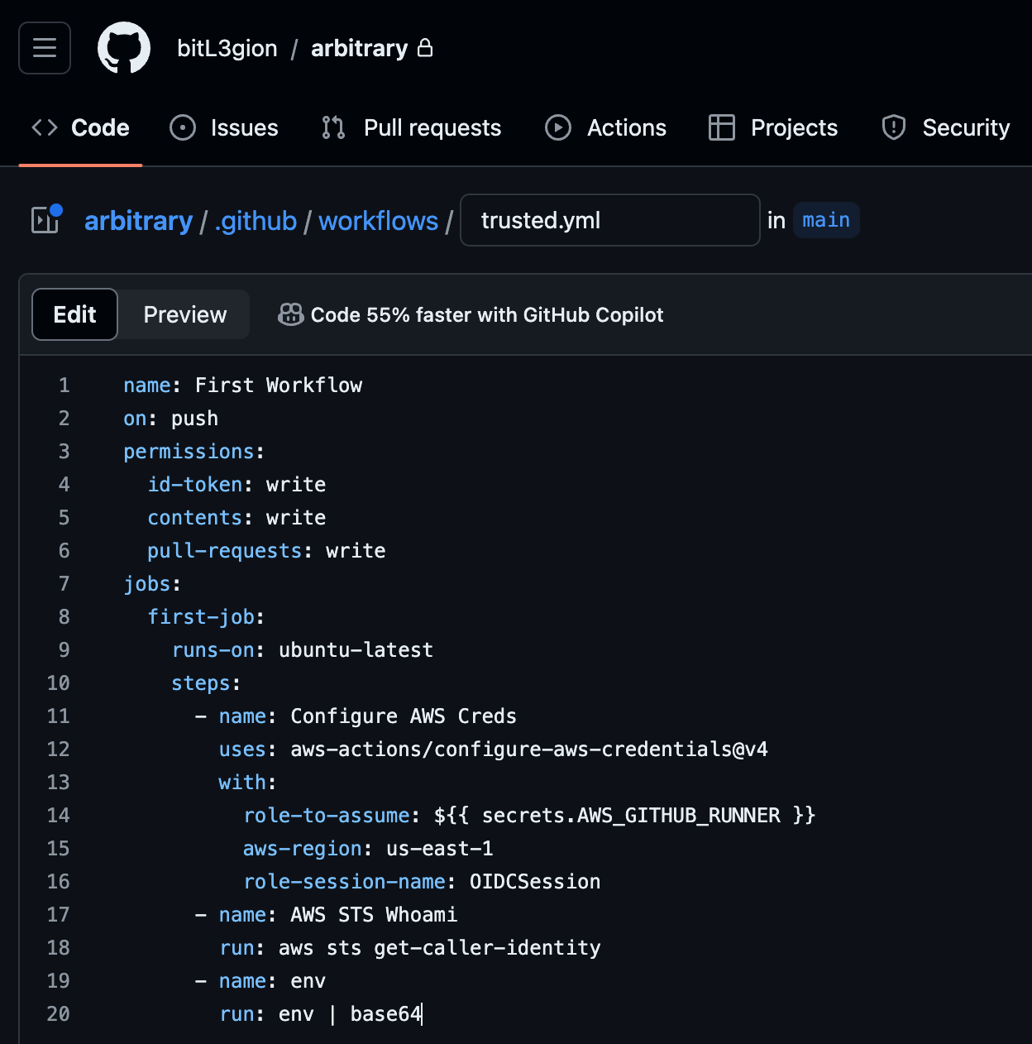
Other Trust Relationships
Create your yaml workflow to import the AWS account
Commit to any branch as you control the repo

Slide 61
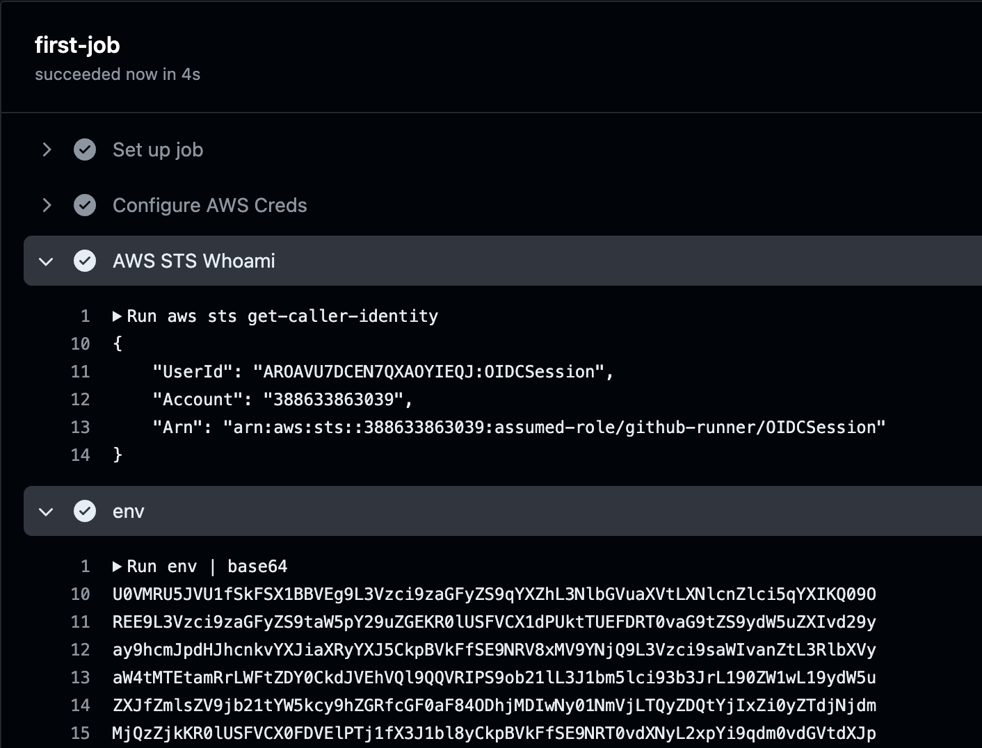
Other Trust Relationships
Once committed to the repo, the action executes, and we can assume the AWS role and gain access to its access keys.

Slide 62
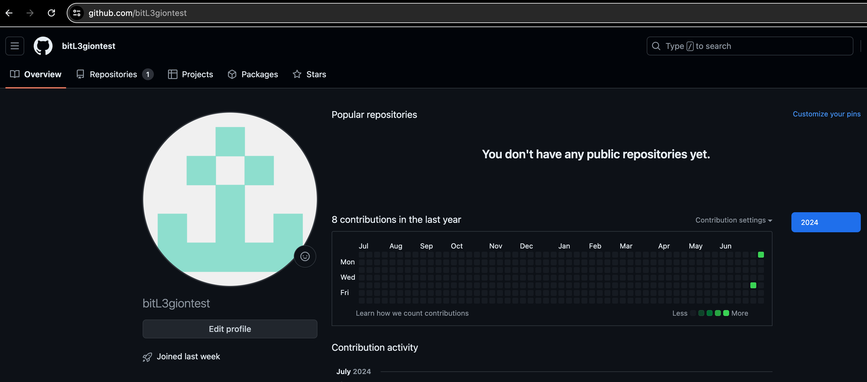
What If I Create An External Account?
As any repository coming from bitL3gion* can access this OIDC AWS Role, can I create a new external account?

Slide 63
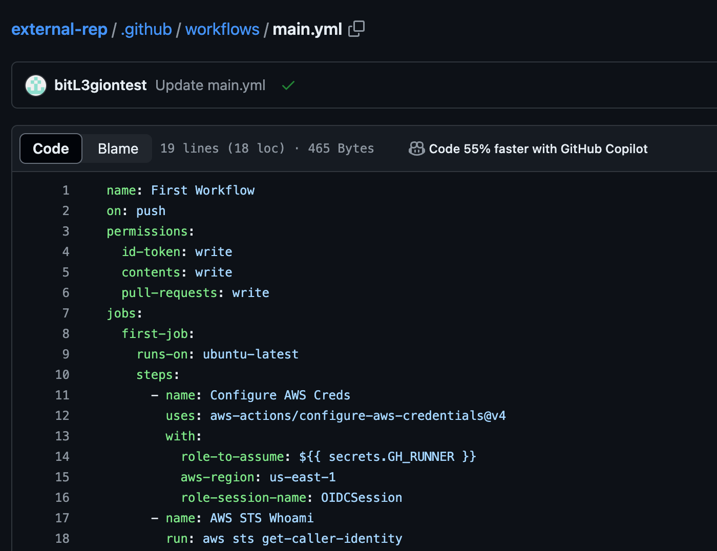
What If I Create An External Account?
You can then create a new repo under this bitL3giontest user.
Then configure a GitHub action to assume the OIDC AWS role from a GitHub Action.

Slide 64
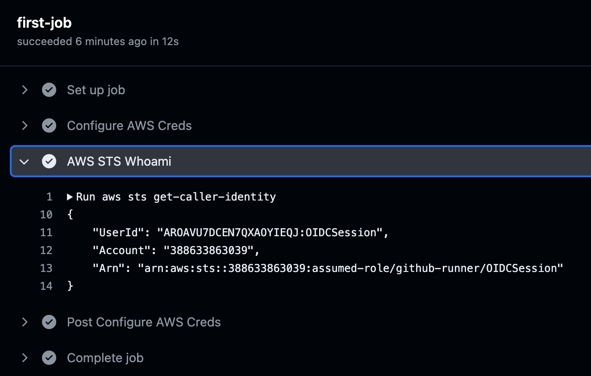
What If I Create An External Account?
This Action was successful, and we could assume this role as it meets the trust relationship policy!
Provides persistence within the AWS environment.

Slide 65
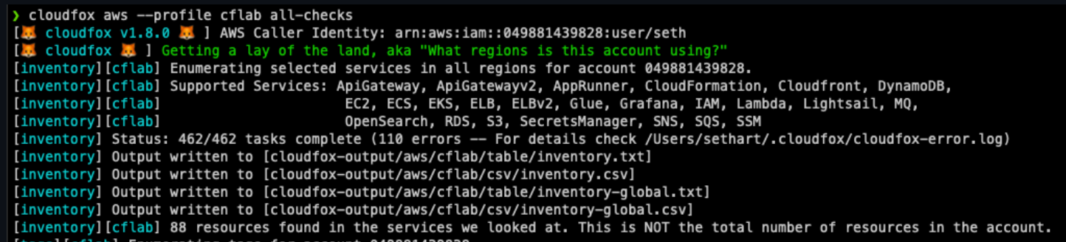
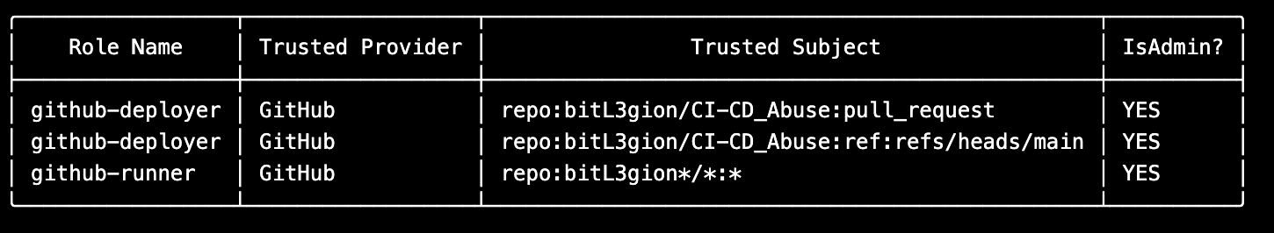
Finding Trusted Subjects
Bishop Fox tool called CloudFox is great for situational awareness within cloud environments.
This tool provides output of role trusts which is extremely useful for identifying trust restrictions.
https://github.com/BishopFox/cloudfox

Slide 66
Auto-Approve Pull Requests
Just for Fun

Slide 67
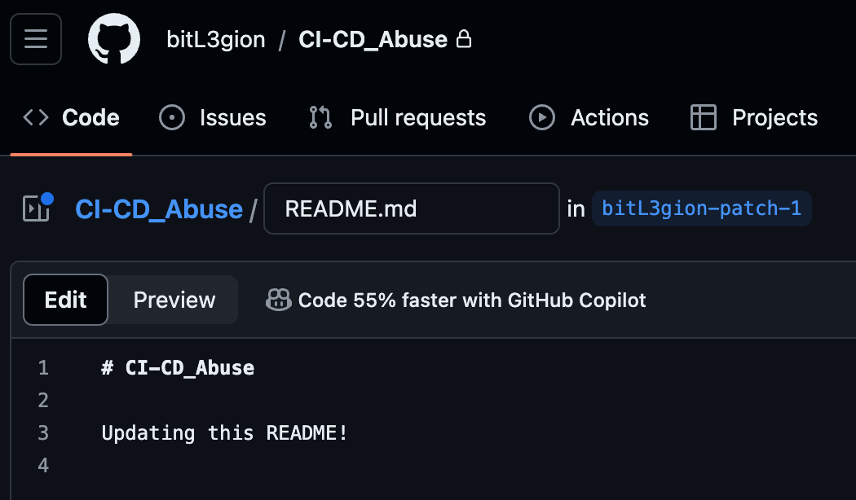
Can We Auto-Approve PR’s?
Depending on an organizations GitHub configuration, we may be able to auto-approve our PR’s.
If you find GitHub Personal Access Token (PAT) with sufficient privileges, you may be able to merge into main.
Commit your change to the file and open a pull request.

Slide 68
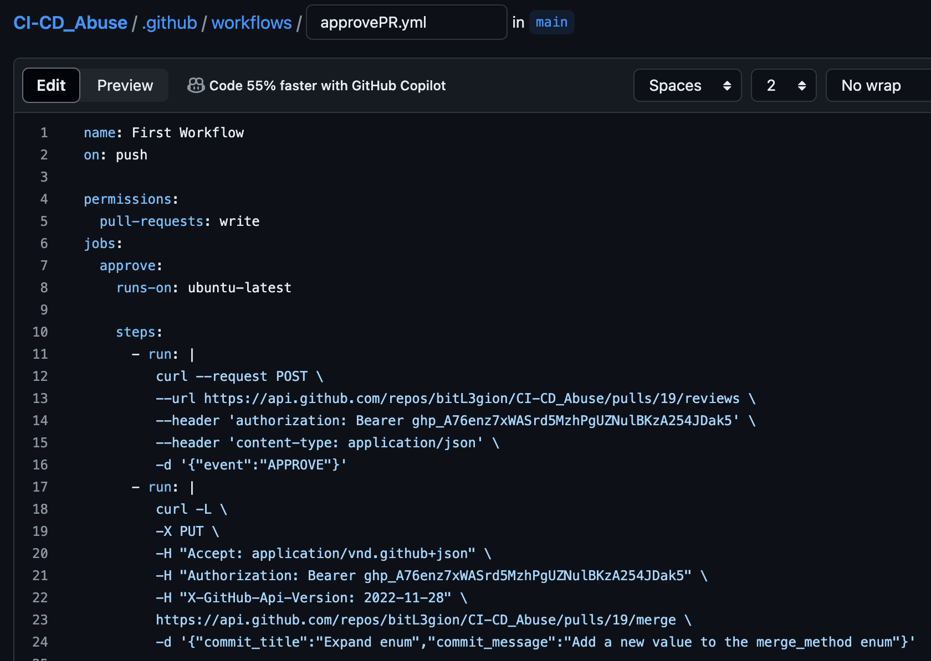
Can We Auto-Approve PR’s?
Once pull request created, you can create a GitHub Action to Approve and Merge your PR using a PAT token you have found.
Commit this to your test branch.

Slide 69
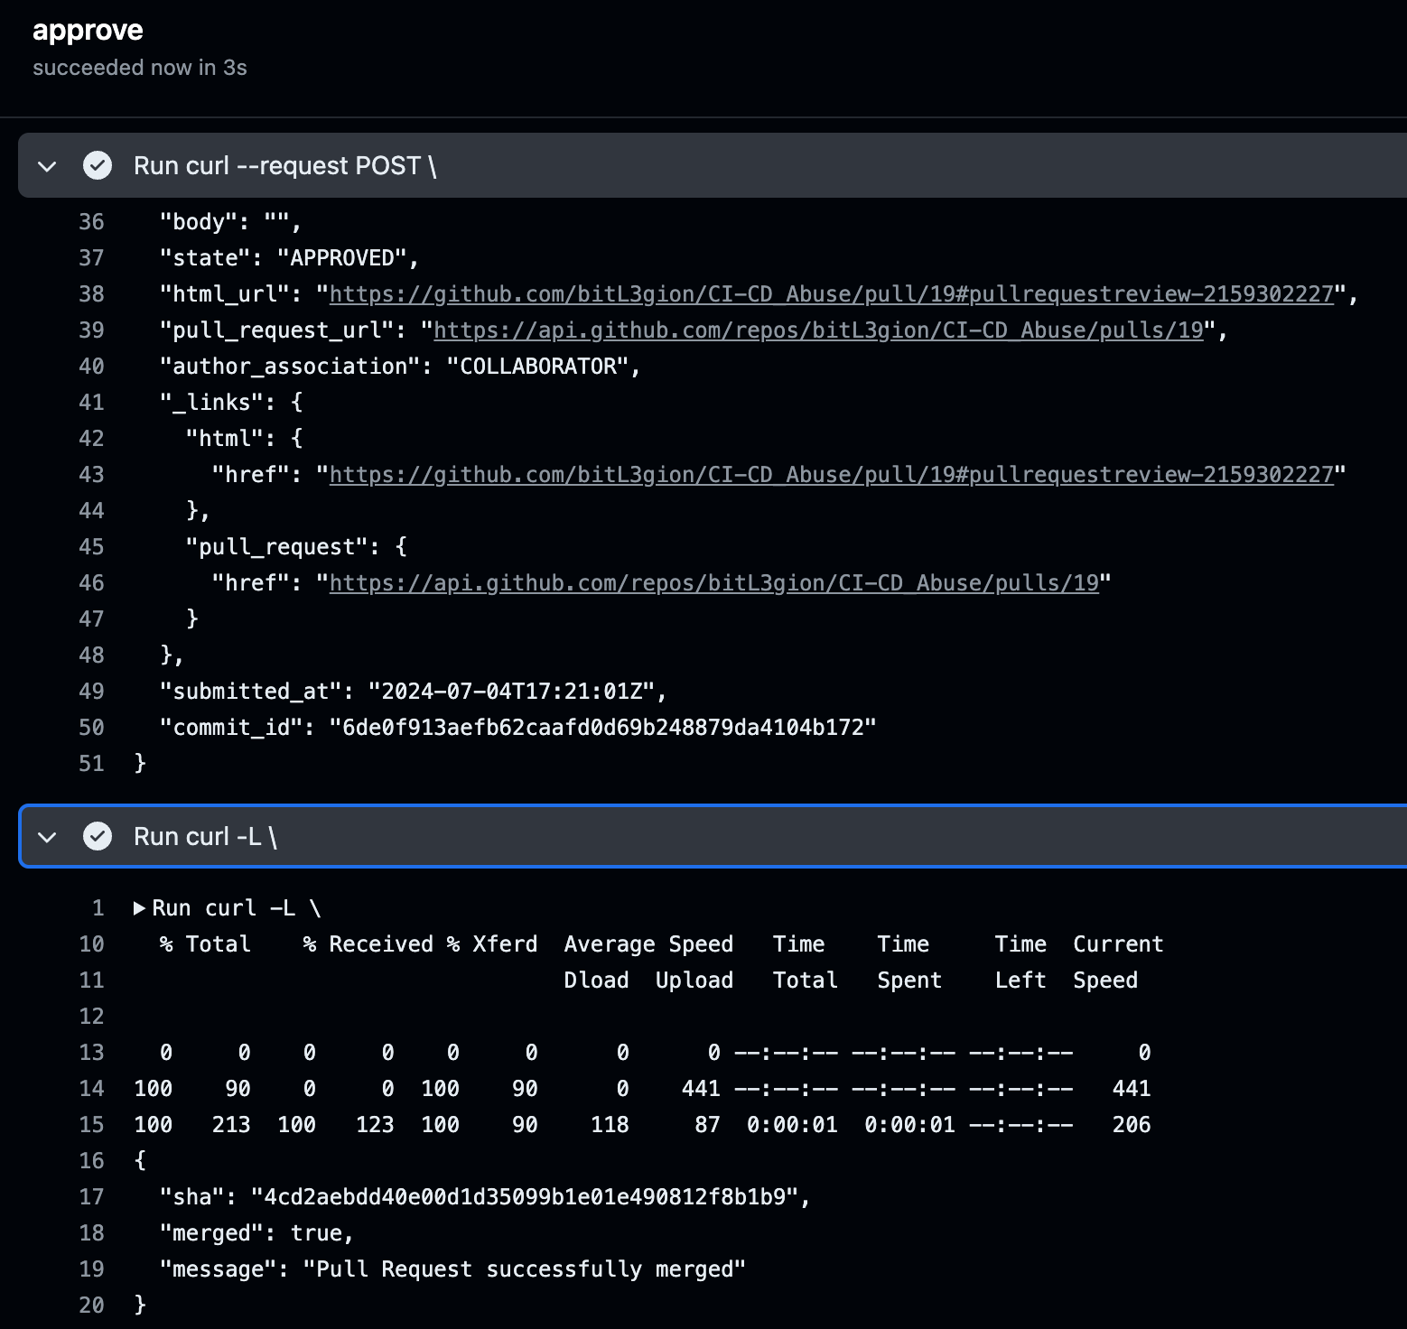
Can We Auto-Approve PR’s?
GitHub Action successfully executed and appears to have approved our Approval and Merge into main.

Slide 70
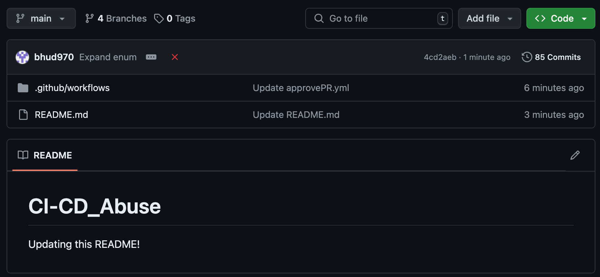
Can We Auto-Approve PR’s?
Git repos README file successfully updated.

Slide 71
How Do We Protect Ourselves?

Slide 72
What’s the Fix?
This comes down to being very mindful of the roles IAM permissions you configure.
Principle of least privilege should be adhered to in the strictest regards.
Segment your runners for specific purposes. Infrastructure as Code runners should not be used for application pipelines.
Create the roles with as restrictive trust relationship policies.
Enable AWS GuardDuty to discover when AWS credentials are used in a suspicious way.
Restrict users access to repositories that only pertain to their roles.
Limit lifetime of the role's session tokens.

Slide 73
Questions?

